Slide 1

Friends of Scouting 2026: Unit Coordinator Training
1

Slide 2
Tonight’s Agenda
Campaign Overview
Unit Coordinator Role

Slide 3
Campaign Overview

Slide 4
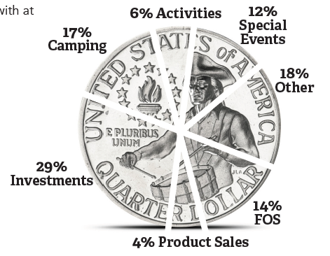
Impact on Council Budget
$925,000 Field (District) Goal for 2026
4

Slide 5
Friends of Scouting Field Campaign Elements
Leadership
The leadership campaign is where everything gets started. It is the opportunity for our council and district volunteers and major donors to set the tone of the campaign.
Family
The family campaign is where we provide our units and families an opportunity to support Scouting. Usually done through unit presentations; this is the largest part of our campaign.
Community
This part of the campaign is where we encourage community members and businesses to give to Scouting. This campaign includes the Community Breakfast, the Skillicorn BBQ, & Corporate Pinewood Derby.
3

Slide 6
Field (District) FOS Campaign 2026 vs 2025 Results*
* As of 1/02/2026
5

Slide 7
Family & Leadership Campaign 2025 Results*
1,955 Individual Donations (excl matches)
$720,997 (incl matches)
$369 Average Gift Value
~ 26% Fam ilies Giving
* As of 1/02/2026
5

Slide 8
Campaign Timeline
Date
Dec ‘25- Jan ’26
Task
Determine the time and date for your Friends of Scouting presentation
FOS Unit Coordinator Training
Conduct Unit FOS Presentations and follow up
Conclusion of 2025 FOS Campaign
Conduct District Clean-Up Campaign
Unit Recognition at District Award Banquets
January
January- May
June
June - July
Fall ‘26
23

Slide 9


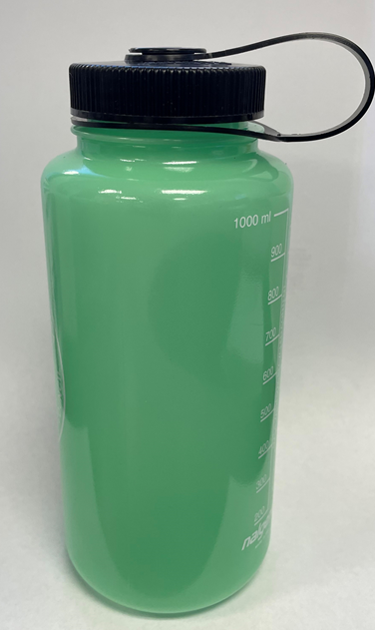
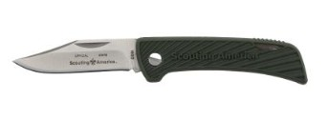
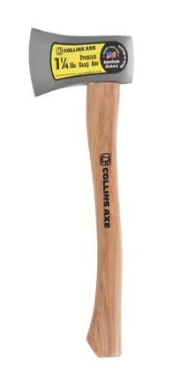
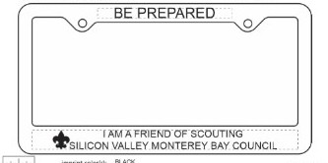
2026 FOS
Recognition Levels
Giving Levels
$1-199: Sticker
$200: Collectable Council Shoulder patch
$375 - Support 1 Scout: License Plate Frame
$750 - Support 2 Scouts: Nalgene Water Bottle
$1,000- First Class: Pocket Knife
$1,500- Support 4 Scouts: Axe
$2,500- Support a Den or Patrol: All 4 gifts

Slide 10
Unit Recognition
Gold: Financial Goal Met
Unit Ribbon and Recognition at District Dinner
Silver: 100% Participation
All families in attendance at the presentation return a pledge card
Unit Ribbon awarded at presentation
Unit Drawing
End of the event, one returned pledge card is drawn for a gift

Slide 11
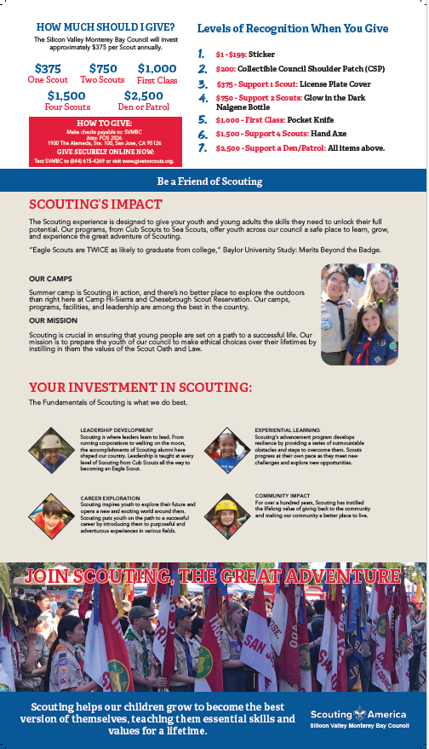
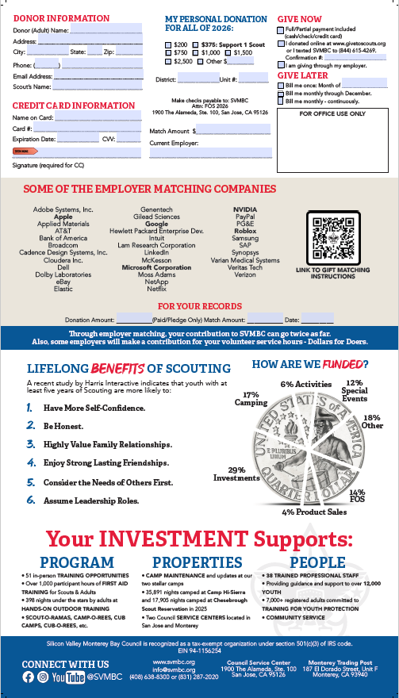
2026 FOS Brochure

Slide 12
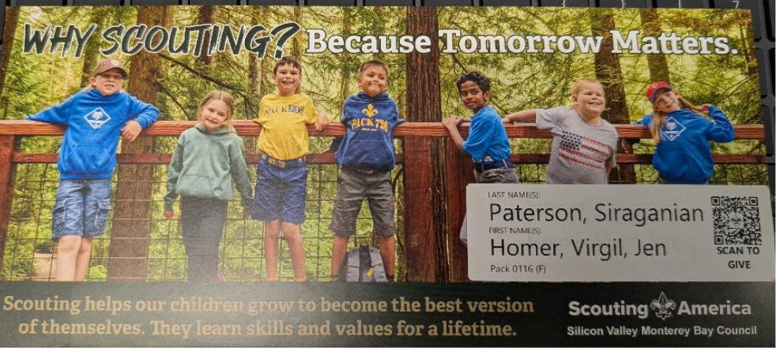

Personalized Brochure
Label applied on outside of brochure
Label will have district-specific QR code

Slide 13
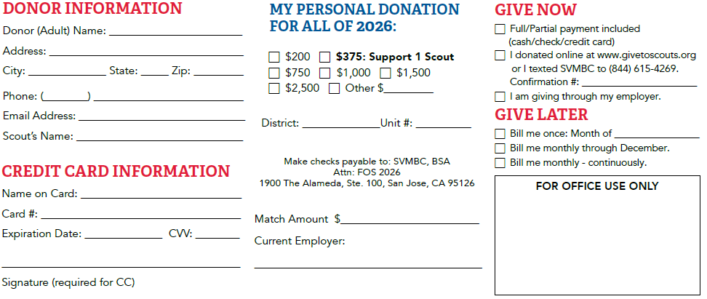
Pledge Card in the Brochure
Excl. Match
Donation Amount divided by remaining months

Slide 14
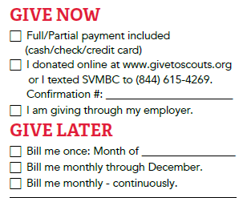
Give Now
Pledge Card – Cash, Check, Amex, Visa, MC, Discover
Online at www.GiveToScouts.org or Text-To-Give: (844) 615-4269, message: SVMBC – Amex, Visa, MC, Discover, Amazon Pay, ACH (bank account)
Employer giving portal (i.e. Benevity)
Ask the family to fill out a pledge card even if giving Online or through Employer Portal.
14

Slide 15
Give Later – Pledge Only Today
Bill me once – designate month to be billed
Bill me monthly – Total donation amount divided by the remaining number of months in the year. Council will send monthly bills
Bill me monthly – continuously – same as Bill me monthly except will continue until cancelled
Invoicing will be both paper and electronic (email).
– Note: electronic bills can also accept Google Pay and soon to accept Apple Pay
14

Slide 16
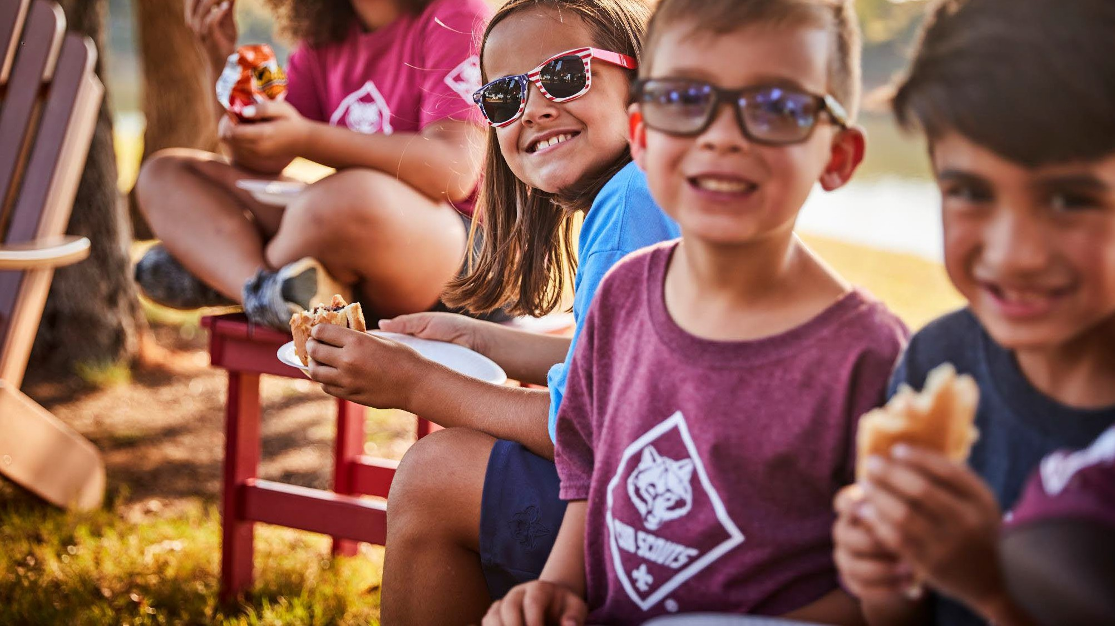












In 2024, SVMBC received $224,172 in Employer Giving
Employer Matching
Provides the opportunity for
employees to make a charitable donation which is then matched by their employer matching at a ratio of
1:1 or higher.
Dollars for Doers
An employer contribution program that donates cash grants to our council, based on the time that the employee volunteers in Scouting.
Examples:
Apple: $25/hr volunteered Microsoft: $25/hr volunteered Google: $10/hr volunteered
Notes:
Did you know that you could leverage your employer to make your gift to scouting go further? Corporate Matching
Provides the opportunity for employees to make a charitable donation which is then matched by their employer matching at a ratio of 1:1 or higher. Some companies even match 2:1. Dollars for Doers
Is an employer-contribution program that donates cash grants to our council, based on the time that the employee volunteers in Scouting. Apple, Google, Microsoft, Facebook, EBAY, Adobe, Netflix, Nvidia and more all match gifts and participate in Dollars4Doers.
Some Examples of Dollars For Doers with local companies here in the Bay Area:
Apple: $25/hr volunteered Microsoft: $25/hr volunteered Google: $10/hr volunteered
There is an old saying that being a scout leader is only “1 hour a week” or work. If that was actually true, then just “1 hour a week” of volunteering, can provide up to $1,300 in extra support for SVMBC, if you contact your company. To learn more. visit www.svmbc.org/support or contact your company’s HR dept.
Dollars For Doers and Corporate Matching both go towards your unit’s Friend’s of Scouting Goal.

Slide 17
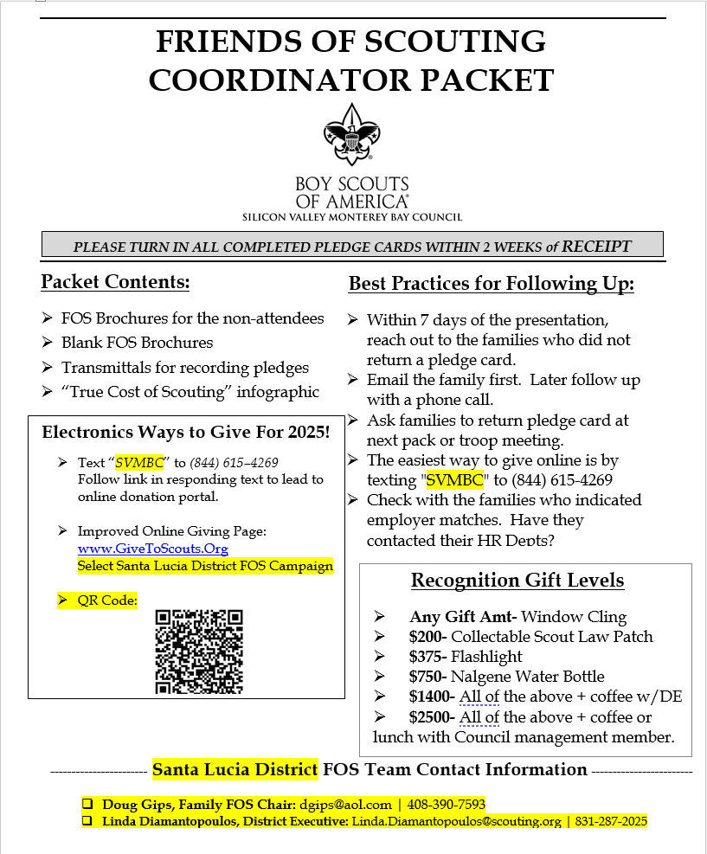
FOS Packets
Left with Unit Coordinator after presentation
Key Information
on outside:
Best Practices
Recognition Gifts
District Volunteer contact info
Electronic Ways to Give:
Text-to-Give
Web Address
QR Code
Contents:
Personalized FOS brochures (for families who didn’t attend)
Blank FOS brochures
Transmittals
True Cost of Scouting infographic (Iceberg Analogy)

Slide 18
AUTOMATION
Email reminder to unit parents one week before presentation.
Email reminder to unit parents one day before presentation.
Text to unit parents the day of meeting with online giving link.
Email thank you message to unit parents one day after presentation with online giving link.
Email thank you message to unit parents one month after presentation with online giving link.
Notes:
Recognition Program
This year’s recognition items for each level are:

Slide 19

The Role of Unit Coordinator
20

Slide 20
Being An FOS Coordinator - What Does That Mean?
Your Role
Provide leadership for your unit’s 2026 Friends of Scouting campaign.
Work with district FOS team to schedule presentation.
Prepare families for their unit FOS presentation by sending out communication and information.
Arrange for a unit leader to endorse the campaign.
Follow up with Families who have not given to ensure your unit reaches its goal.
Discuss FOS status at Pack/Troop/Committee meetings
Your Goal
Get 100% family participation (includes $0 pledges)
Meet the unit’s FOS financial goal by May 31.
Notes:
One of the main purposes for our presentations is to raise funds for scouting, but as importantly, it is also about communicating the impact of scouting.

Slide 21
Best Meeting Options
Court of Honor, Blue and Gold Dinner, Mandatory Parents Meetings.
Anywhere you will have critical mass of parents and the highest turn out.
For Cub Scout events, consider separating the parents for the presentation while den leaders occupy the scouts with a short, fun activity.
24

Slide 22
Before the Meeting
FOS Unit Coordinator contacts District FOS Family Chair and District Executive to communicate:
FOS Coordinator name and contact information
FOS Presentation – Date, Time, Location, Type of event
Obtain your Unit FOS Goal from your District FOS Family Chair.
Introduce yourself as the FOS Unit Coordinator to all families in your unit. (Share your unit goal, include text-to-give and URL link. Highlight the importance of Friends of Scouting).
You will be assigned a Presenter by the District. Be sure to communicate any changes or relevant details to them ASAP!
Arrange for the Presentation to be near the top of the agenda.
Arrange for a unit leader to add personal words of support and publicly be the first to return a pledge card.
1-week before the date of the FOS presentation.
Send a reminder to the families in your unit about the upcoming FOS Presentation. Remind them to bring their checkbook, or credit card.
Notes:
Meet with the Unit Coordinator as soon as date is secured and follow up two weeks prior to the presentation.

Slide 23
Immediately After FOS Presentation
Send a Thank You! note to all of the families for their contributions.
Communicate how much money was raised.
Remind the families about the ways to make their gift go further (employer matching, Dollars for Doers, etc.).

Slide 24
After the FOS Presentation
1-week after the date of your FOS presentation.
Follow up with the families that were absent the night of the FOS presentation; remember that every family deserves the opportunity to contribute to Friends of Scouting.
1-month after the date of your FOS presentation.
Send an e-mail update with the total amount of money raised, thank those that have contributed and encourage folks to donate if they have not done so yet. Don’t forget to include the URL to give and highlight the importance of Friends of Scouting.
 Continue to share e-mail updates with all the families in your unit on a monthly basis.
 Regularly Check with your district’s FOS Family Chair or your Unit’s FOS Google Sheet. This will show you what gifts have been received by whom.

Slide 25




Best practices for success:
Continuously communicate with your District FOS Family Chair and District Executive
Encourage families to give at ANY level they are comfortable.
POLARIS ONLY: Update and review your personal Google tracking sheet to ensure that gifts are being recorded and received and that all record keeping is current.
The best way to follow up is to make personal contact. If emails are not getting you the engagement you hoped for, pick up the phone and call.
There are lots of resources and volunteer support available to you. Do not be afraid to ask for help if you need it.
PLEASE: Turn in any additional FOS pledge cards ASAP. Contact your DE to pick them up!
Celebrate your Victory!
28

Slide 26
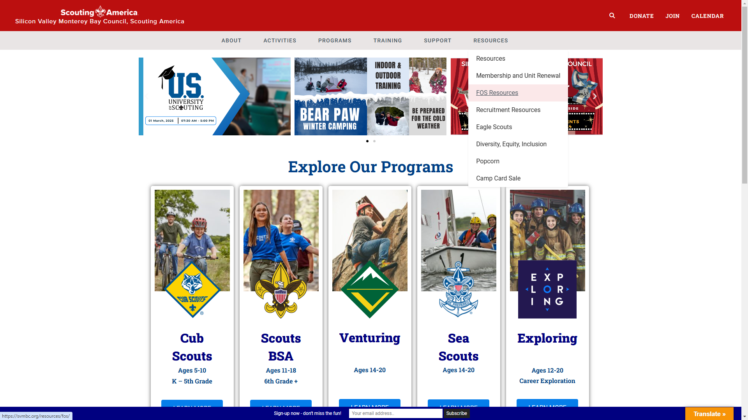
Resources Available
SVMBC FOS Resource Page (https://www.svmbc.org/resources/fos/)
Unit Coordinator Guide
FOS Brochure
Email Templates and More
30

Slide 27

Your Help Matters.
Thank you for making this year’s campaign a Success.
31

Slide 28
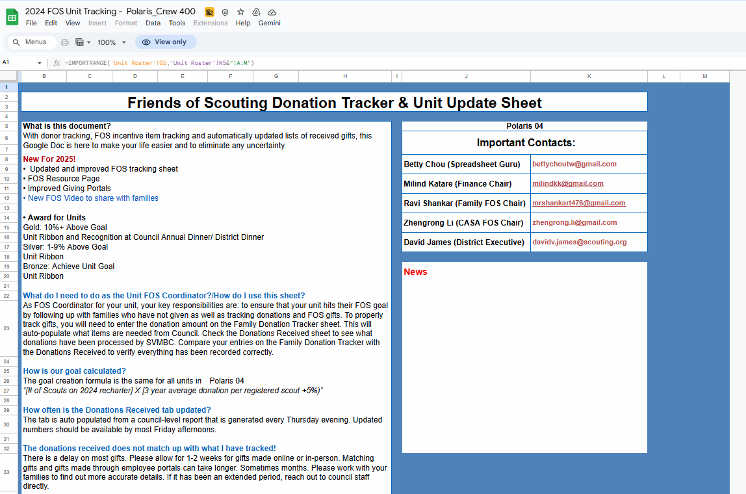
About/FAQ
28

Slide 29
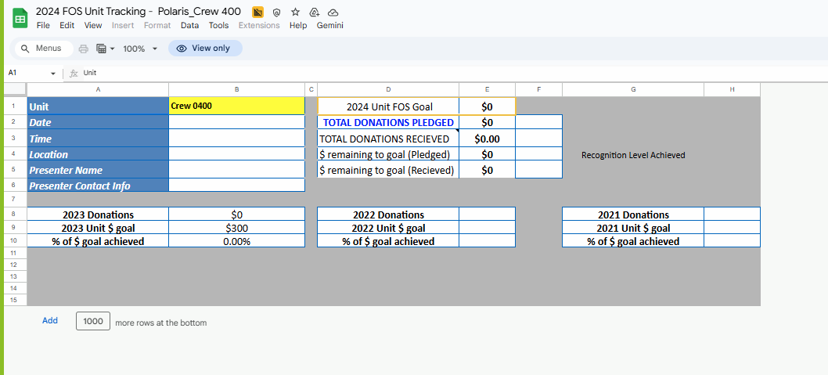
Unit Donation Info
28

Slide 30
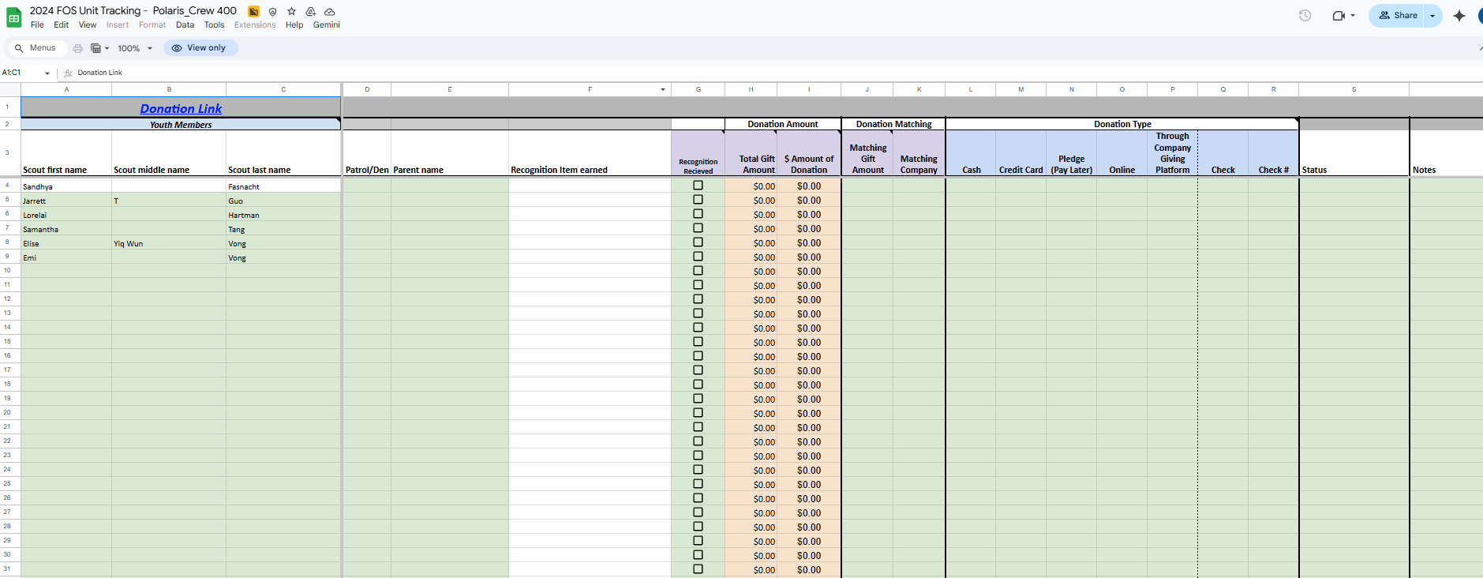
Donation Tracker
28

Slide 31
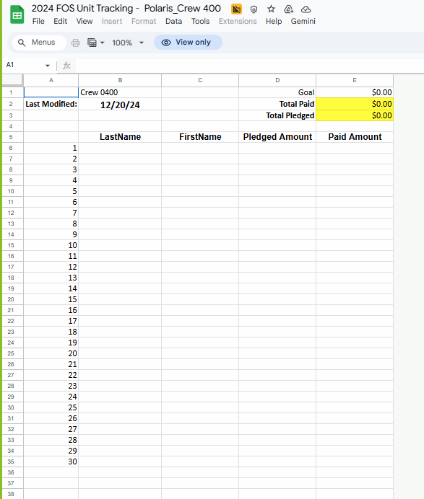
Received By Council
28

Slide 32
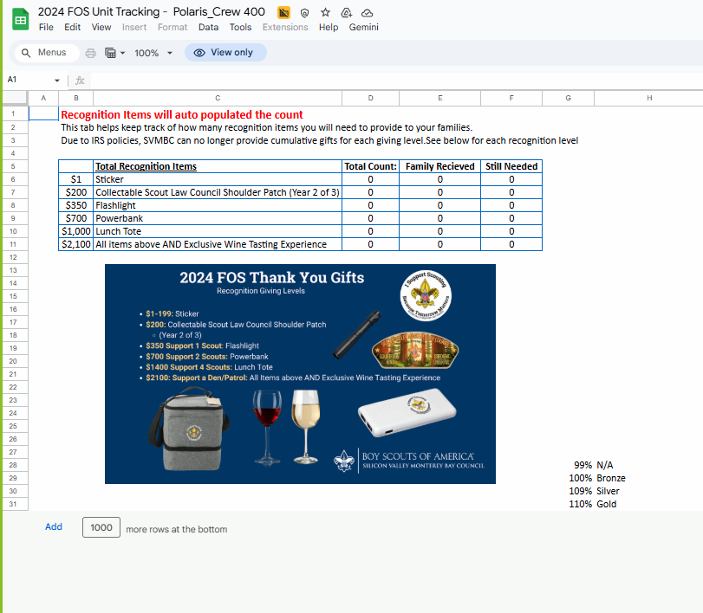
Recognition items
28

