Slide 1


The Friends of Scouting Presentation
How To Be A Successful FOS Presenter
Notes:
Introduction:
- Start with a sample FOS Presentation

Slide 2
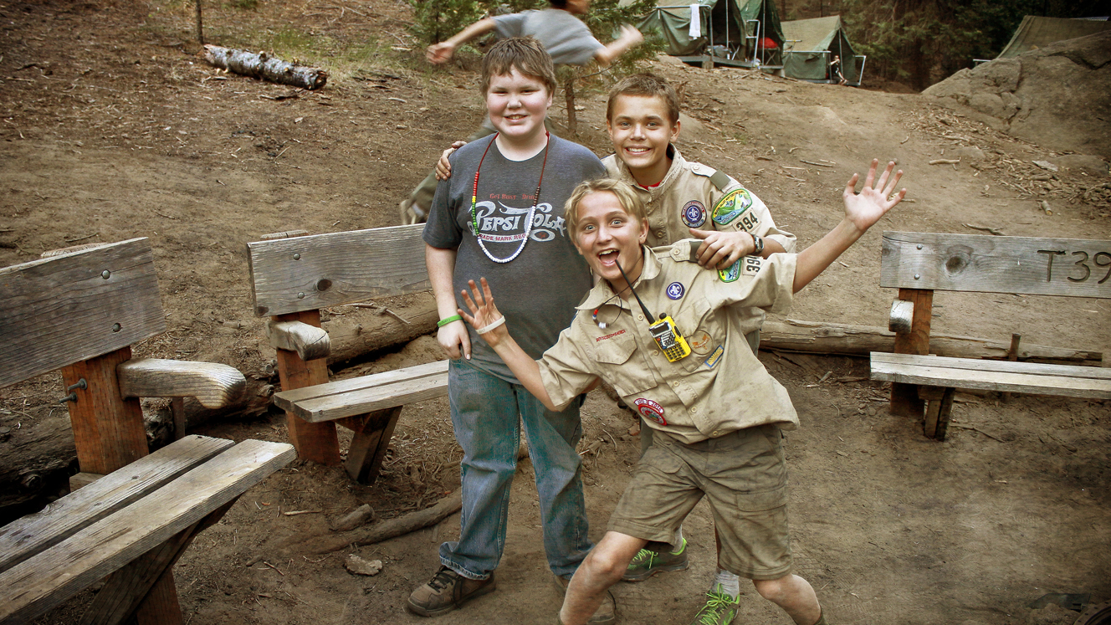

WHY DO FOS?

Slide 3

Why do FOS presentations at units??
No. It’s not to get more money.
NPO research shows that people who donate to the organization STAY almost twice as long as those who don’t donate, even if they volunteer time.
We need EVERY family to hear EVERY year about the value Scouting provides to their family, their children, and the community at large.

Slide 4
Why do people give?
Psychology Today study:
85% of Americans give to charity because they were asked to give.
Charity Aid Foundation study:
96% of people feel a sense of duty to give back to society (altruism).
75% gave because they felt passionately about a specific cause (relatability).
71% felt motivated to give thanks and support those less fortunate (moral duty)
Other reasons included knowing that charities can’t survive without financial backing (trust) and the personal satisfaction gained from giving (egosim).
Notes:
Most people don’t give unless they are asked. So, we ask.
Giving back to society resonates with almost everyone who gives

Slide 5
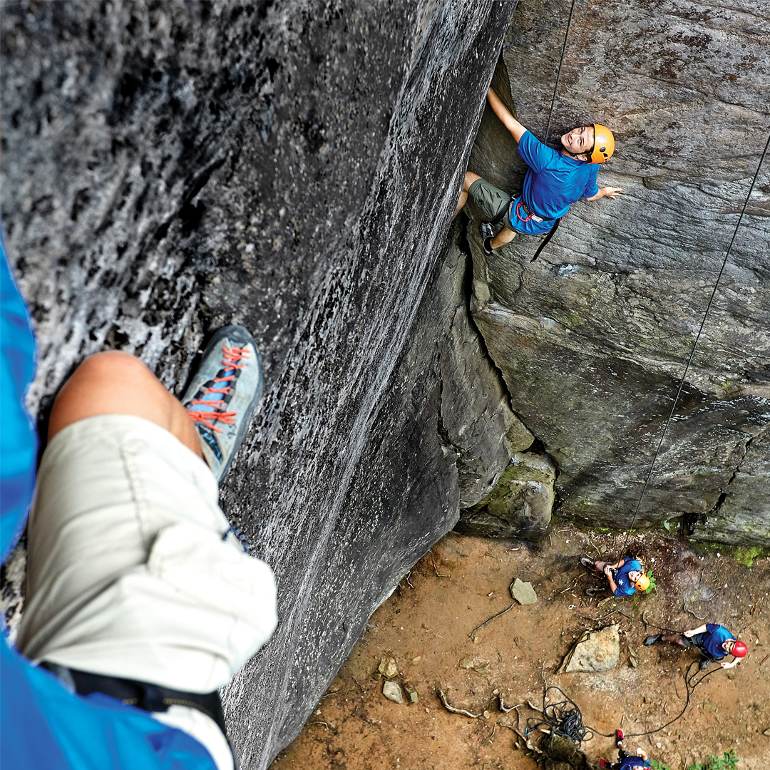
The Laws of Fundraising
People give to people, not organizations.
Few people make a gift without being asked and . . . no one increases their giving without being encouraged.
No one has been asked to give too much. Many have been asked for too little.
The more personal the message, the greater the rate of success.
Paper (emails, facts, brochures) only inform. But people inspire ...
Notes:
Why People Give
Here are a few guiding principles:
Special note on rule four: It is up to you to know what kind of relationship you have with an individual and what kind of communication works best, but the more intimate the type of communication the greater rate of success. So sometimes an email will work, but usually an in-person ask is required

Slide 6
Don’t bombard with facts. Instead, explain WHY Scouts and WHY give to SVMBC. Then, ASK for a gift to Scouting

Slide 7
Your Messaging – Why Scouts?
To give youth the skills they need to unlock their full potential in a safe place to learn, grow, and experience the great adventure of Scouting.
To prepare youth to make ethical choices over their lifetimes by instilling in them the values of the Scout Oath and Law.
Because tomorrow matters.
Convey the message through a personal story about Scouting making a difference in a young person’s life.

Slide 8
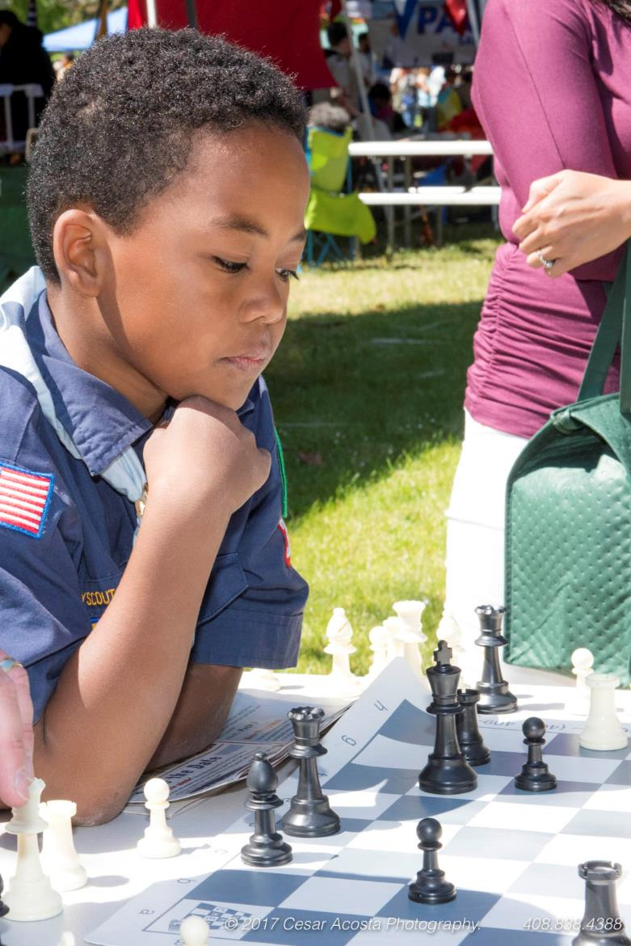
PRESENTATION TIPS
Make eye contact with members of the audience.
Don’t mumble. Speak clearly and slowly.
Project sincerity and pride of volunteering in Scouting
Be brief! No more than 5-8 minutes.
Do not try to cover everything in your presentation.

Slide 9
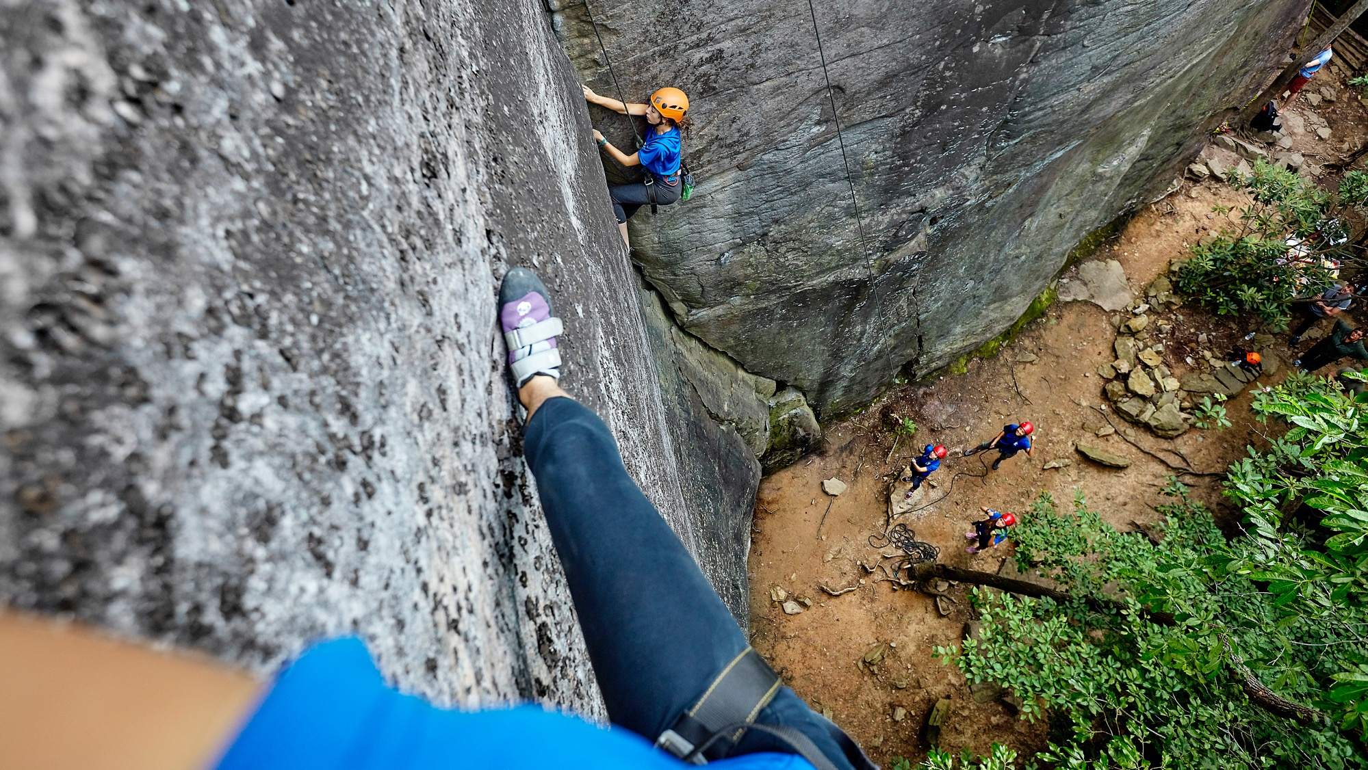
THE FOS PRESENTATION

Slide 10
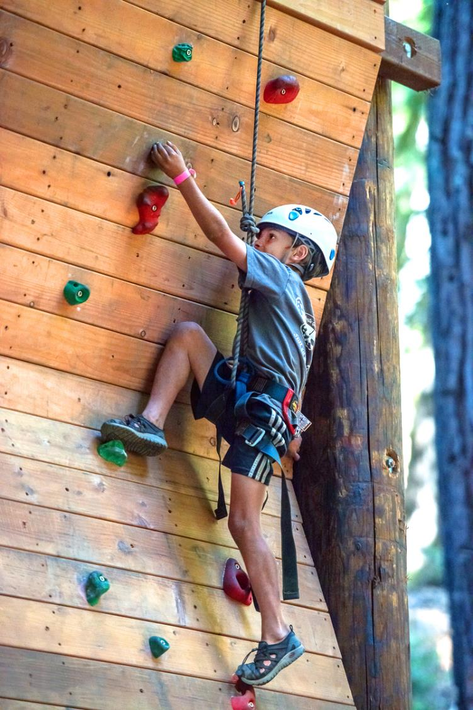
TWO WEEKS BEFORE THE MEETING
Communicate your needs to the Unit Coordinator
Help with various tasks (see next slide)
Table & chair
Etc
Communicate unit’s goals
Dollar goal
100% participation & participation definition
Request to be scheduled shortly after opening flags.
Request a Unit Leader endorsement and public pledge to be given immediately after your presentation.

Slide 11
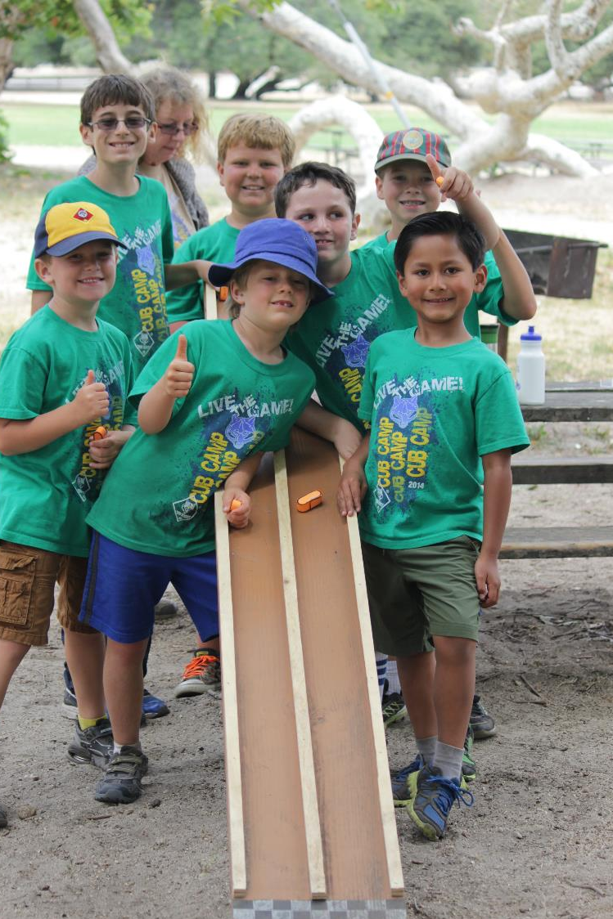
RECRUIT HELP
Arrive early to meet the leaders and ask for help.
Scouts or Leaders – distribute the name-labeled brochures to the correct families.
Unit Leader to endorse the campaign and be the first one to conspicuously turn in pledge card.
Unit Leader to ask families to fill out their pledge cards and hold them up for collection.
Den Leaders personally collect their den’s pledge cards.
Notes:
Recruit Help
Arrive Early in Full Uniform (20 Minutes Prior to Meeting Start
Coordinate your introduction with person that will be introducing you.
Arrange for the Unit Leader or scouts to handle the distribution of the FOS cards.
Explain to the Scouts that you will be making a presentation and you need them to begin passing out the materials soon after you are introduced.
Recruit a Time Keeper. Ask him/her to signal you when you have reached the 3‐minute mark so that you can wrap up your presentation.

Slide 12
WHAT YOU WILL BRING
Your DE will prepare:
Presenter Box (identical for all presentations)
Recognition items
Gold- Goal Met Ribbons
Silver- 100% family participation ribbons
Brochures
Pens
Blank Transmittals
Presenter Tips, Presentation Organization Structure, and Gift Giving Rules
True Cost of Scouting infographic

Slide 13
WHAT YOU WILL BRING
Your DE will prepare:
Presenter Packet (unit-specific)
Labels with families’ names & QR Code for brochures
Labels with only QR code (if not using name label)
Roster (to help track participation at presentation)
Coordinator envelope (to leave with the unit)
Presenter envelope (for holding cash, checks, & pledge cards)
Event location, time, goal amount, and leader contact info

Slide 14
THE PRESENTATION
Include an impactful Story (Importance of Scouting)
Explain the role of the Council, how the Council is funded, and what the units get from the Council.
ASK FOR THE PLEDGE TODAY. NOW.
Suggest at least $375.
Explain pledges can be paid today or billed later.
Employer matching and Dollars for Doers.
Show recognition gifts. Explain ribbons and drawing.
Be brief! No more than 5-8 minutes.
Conclude with the Unit Leader’s endorsement
Notes:
The Presentation
These items are should be included to make your presentation
Impactful Story
Highlighting what the funds support.
Highlight what scouts get out of the program.
Asking the group to make a gift of $375 or other amount.
Asking them to commit today, even if it is only a pledge.
Highlighting matching gifts.
Presentation is only 5-8 minutes.

Slide 15
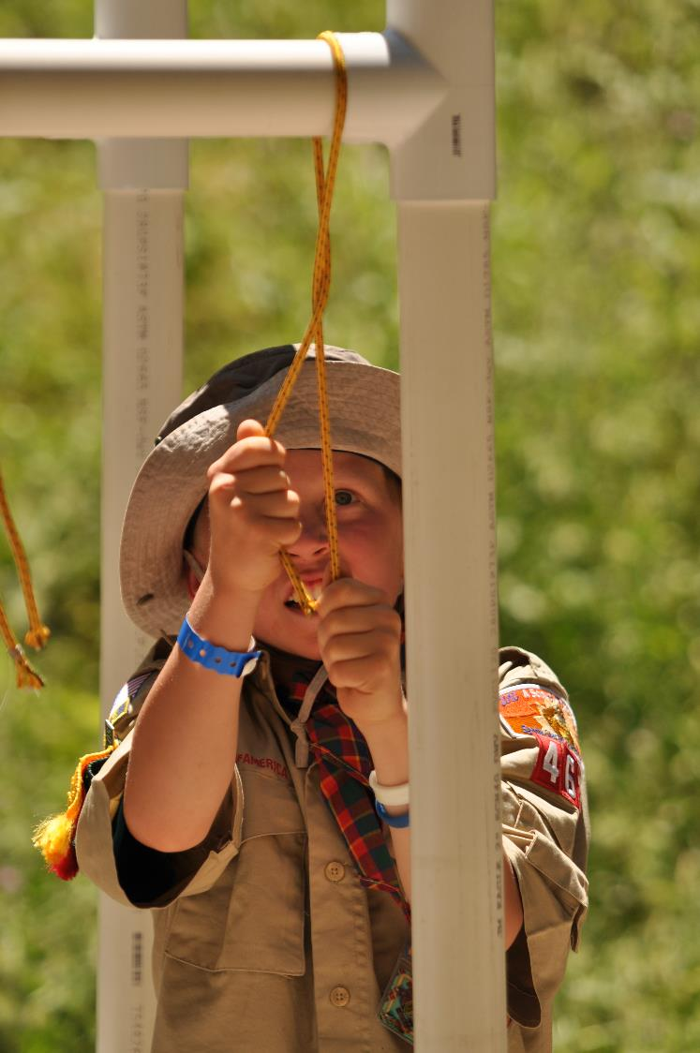
CARD COLLECTING
Ask the Unit Leader to collect pledge cards at the end of your presentation, after his endorsement.
During breaks, dinner, or reception mingle with the parents and ask them if they have returned their pledge cards. Remind them about zero dollar cards
Provide a sincere thank you for each pledge card received and honor the donor’s privacy.
Make sure the pledge card is completed correctly.
Collect a pledge card even when donor is donating online or through employer – Check the box!
Notes:
Card Collecting
Each amount pledged is important. Do not make any judgments based on the amount that someone pledges, and give a sincere “thank you” with each card you receive.
Make sure the card is filled out completely and legibly.
If they are paying with a credit card, make sure they have checked which kind of card they are using.
Most people will not ask for a receipt, but if they do, there is a place on the brochure for you to enter the amount of the gift.
Keep the pledge cards turned upside down so no one can see the amounts.

Slide 16
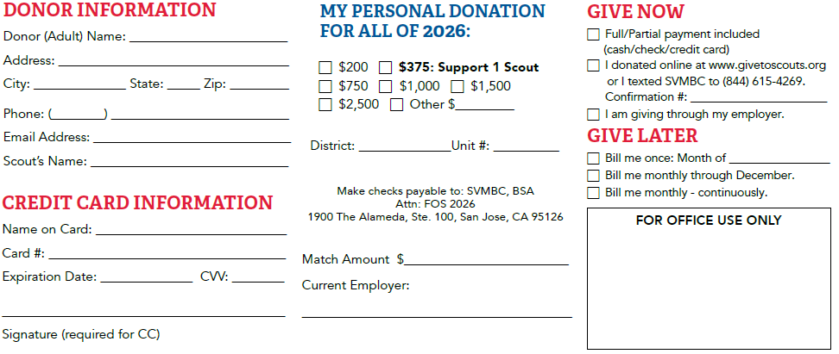

Pledge Card in the Brochure
Excludes Match
Donation Amount divided by remaining months

Slide 17
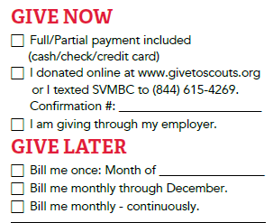
Give Now
Pledge Card – Cash, Check, Amex, Visa, MC, Discover
Online at www.GiveToScouts.org or Text-To-Give: (844) 615-4269, message: SVMBC – Amex, Visa, MC, Discover, Amazon Pay, ACH (bank account)
Employer giving portal (i.e. Benevity)
Ask the family to fill out a pledge card even if giving Online or through Employer Portal.
14

Slide 18
Give Later – Pledge Only Today
Bill me once – designate month to be billed
Bill me monthly – Total donation amount divided by the remaining number of months in the year. Council will send monthly bills
Bill me monthly – continuously – same as Bill me monthly except will continue until cancelled
Invoicing will be both paper and electronic (email).
– Note: electronic bills can also accept Google Pay and soon to accept Apple Pay
14

Slide 19
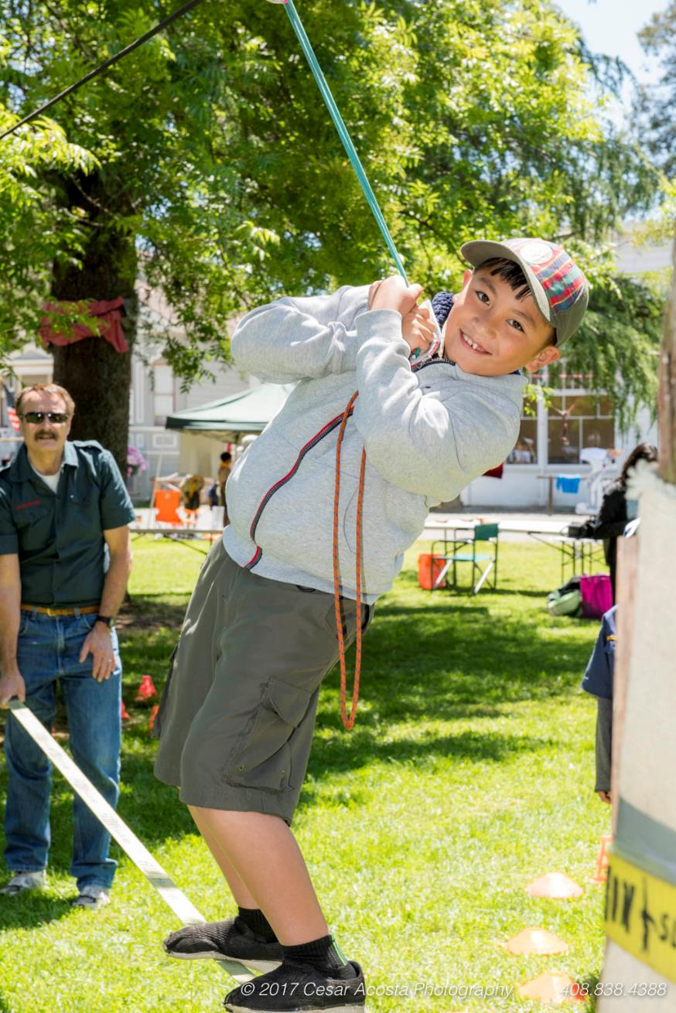
WRAPPING UP
Stay for the entire meeting: many cards are turned in on the way out the door!
Count and prepare transmittal – report the results during the meeting and final results at the end.
Thank everyone for their support.
Distribute the recognition items to the donors or to the unit leader. Ribbons to unit leader.
Leave the unit the Coordinator envelope containing remaining labeled brochures and blank brochures.
Return transmittal and pledge cards to Council in Presenter’s envelope within 2 days.
Notes:
Wrapping Up
Just before the end of the meeting, go back up to the front of the group and thank them for allowing you to make your presentation. Be prepared to tell the group what level of participation has occurred so far tonight. (Last year 23 families participated and gave $2,800, and so far this year we have had 5 families turn in cards for a total of $650. You are well on your way.”)
This is done to remind people that you are there and to let them know how far ahead or behind their giving is from last year. Do not use language such as “only 5 families”, rather use “We already have 5 families.”
Prior to the event closing, announce the Pledge total and if the unit achieved its goal.
Wait by the door until everyone has left to collect any remaining pledge cards
Leave all valid, labeled brochures with the Unit Coordinator in the Coordinator envelope.

Slide 20
AUTOMATION
Email reminders to unit parents one week before presentation and day before presentation.
Text to unit parents with online giving link on day of presentation at noon for weekend presentations & 6:30pm for weekdays.
Email thank you messages to unit parents one day after presentation and thirty days after the presentation with online giving link and QR code.

Slide 21
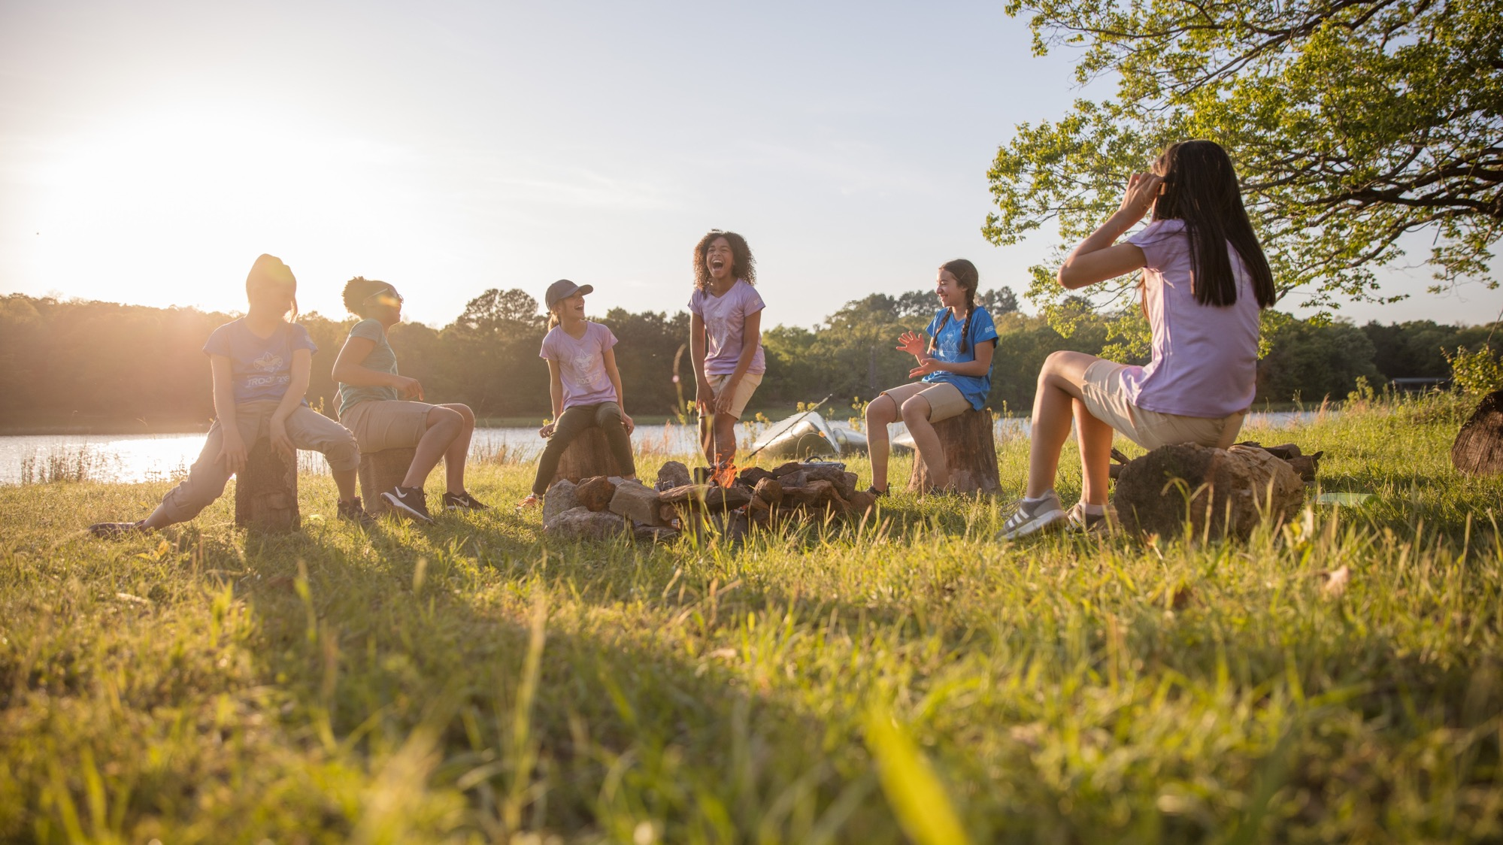
RECOGNITION

Slide 22


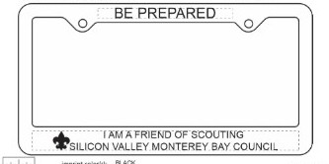
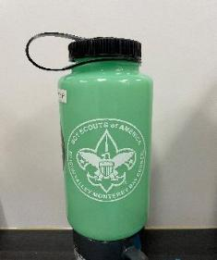
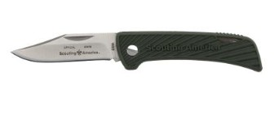
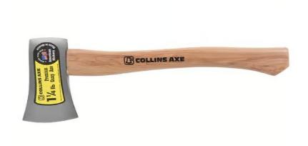
RECOGNITION PROGRAM
$1-$199 Window Cling
$200+ Collectible FOS Council Shoulder Patch
$375 License plate frame
$750 Glow in dark Nalgene bottle
$1,000 Pocket Knife
$1,500 Axe
Notes:
Recognition Program
This year’s recognition items for each level are:

Slide 23
RECOGNITION GIFT RULES
Gift is based on the value of the donor’s personal donation only. Do not include matching amount in the value.
Give the gift for either a Payment or a Pledge without payment.
Give the gift only if they turn in pledge card. No gift without card.
If you run out of gifts, make a list (OWE) and we will make good.
Return your Presenter Box with the remaining gifts to your DE within 2 days. Each district is allocated a set number of gifts and your district could run out if you do not promptly return your gifts.

Slide 24
RIBBONS
Gold Goal Met Ribbon – give for achieving financial goal amount
Silver 100% Participation Ribbon – give if every family who is present at the meeting returns a pledge card. Zero dollar pledge cards count. Not impacted by families not in attendance. This ribbon can only be earned on night of presentation.
Unit can earn both ribbons.

Slide 25
DRAWING
Hold a drawing at the end of the event.
Fan out the returned pledge cards and have a scout pull one card.
The winner can choose any one of the recognition items (cling, patch, license plate frame, knife or axe). Hand the knife or axe to the parent instead of Scout

Slide 26
PRESENTER PATCH
1. Attend one annual Family FOS Presenter training.
2. Conduct two FOS Presentations.
Notes:
Presenter Recognition Program

Slide 27
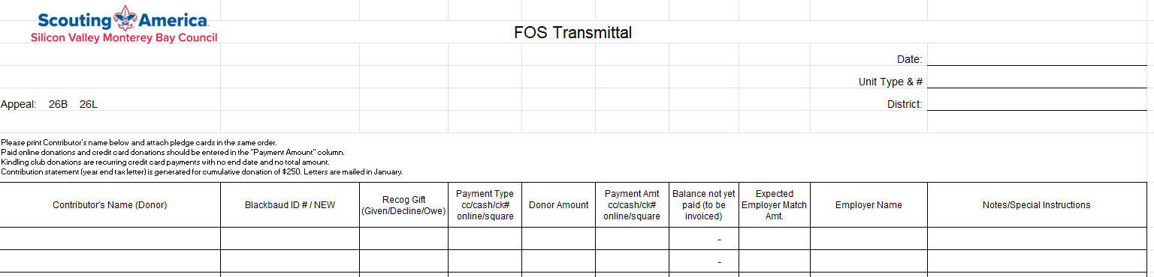
PAPER TRANSMITTAL
Printed in landscape

Slide 28
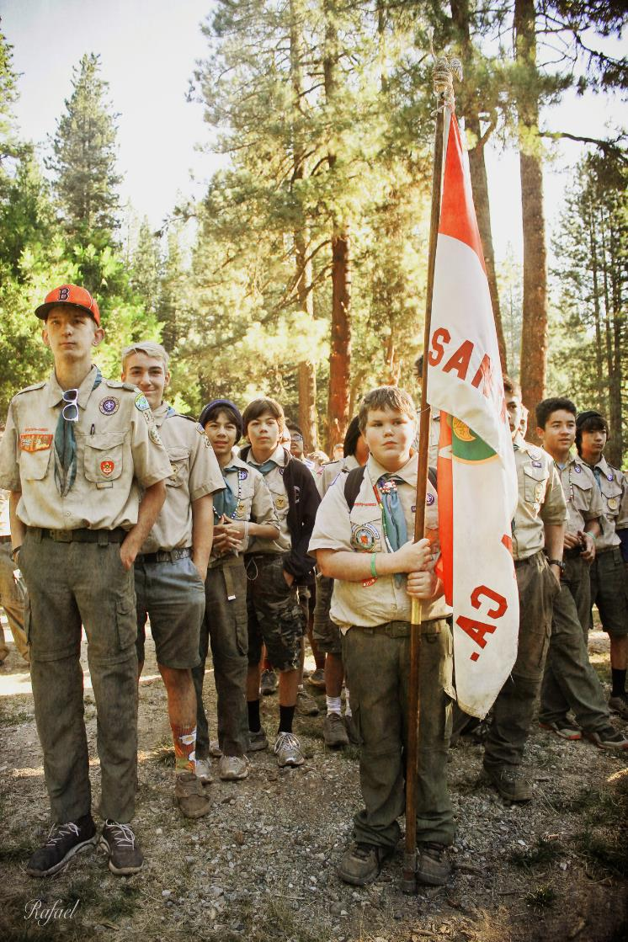
TRANSMITTAL INSTRUCTIONS
# of rows on transmittal = # of pledge cards.
Blackbaud ID: filled out by DE
Recog Gift: was item given or declined or owed?
Donor Amt: the donor’s entire pledge (excl match).
Payment Amt: amount paid by cash, check, CC, Square, online (GivetoScouts) remitted at meeting.
Balance Not Yet Paid: Donor Amt minus Payment Amt. This will be billed to donor in the future.
Payment type: cash, check, CC, Square, or online.
Notes:
Turning in the Donations
Complete Transmittal and arrange for drop off or pick up the next day with the district executive.
Report the presentation results within 24 hours to your FOS Chairman.

Slide 29
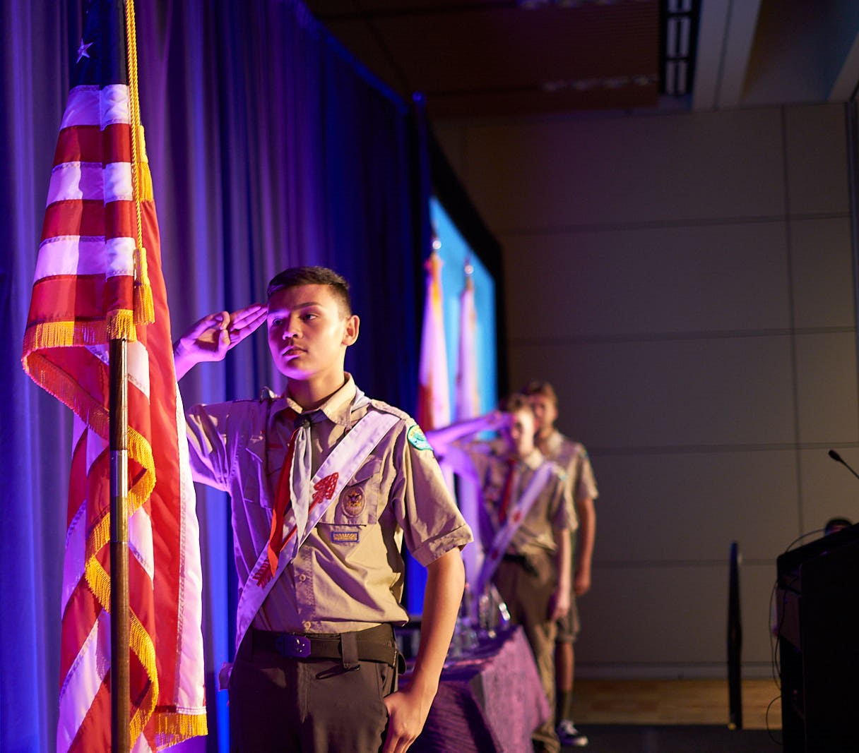
SUMMARY
Communicate Early and Often
Secure Support of Leadership
Tell an Impactful Story
Make The Ask
Collect the Pledge Cards

Slide 30
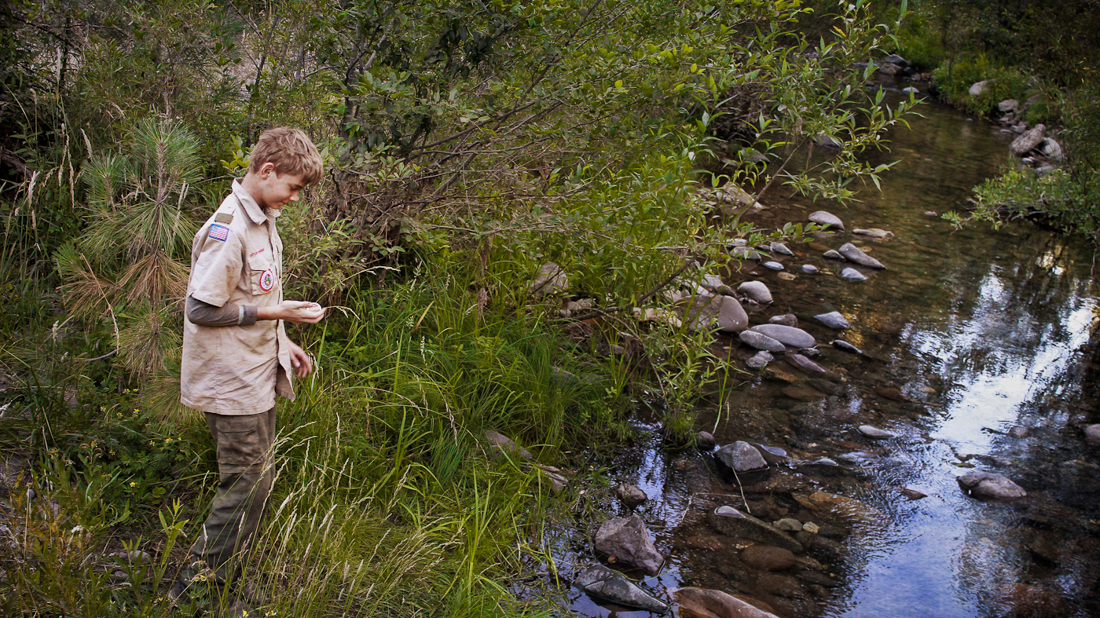
QUESTIONS?

