Slide 1
BSA Annual Membership
and Unit Renewal Process
1

Slide 3
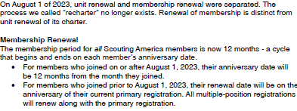

Slide 4
1. Unit Renewal Process
Renewing the Unit Itself

Slide 6
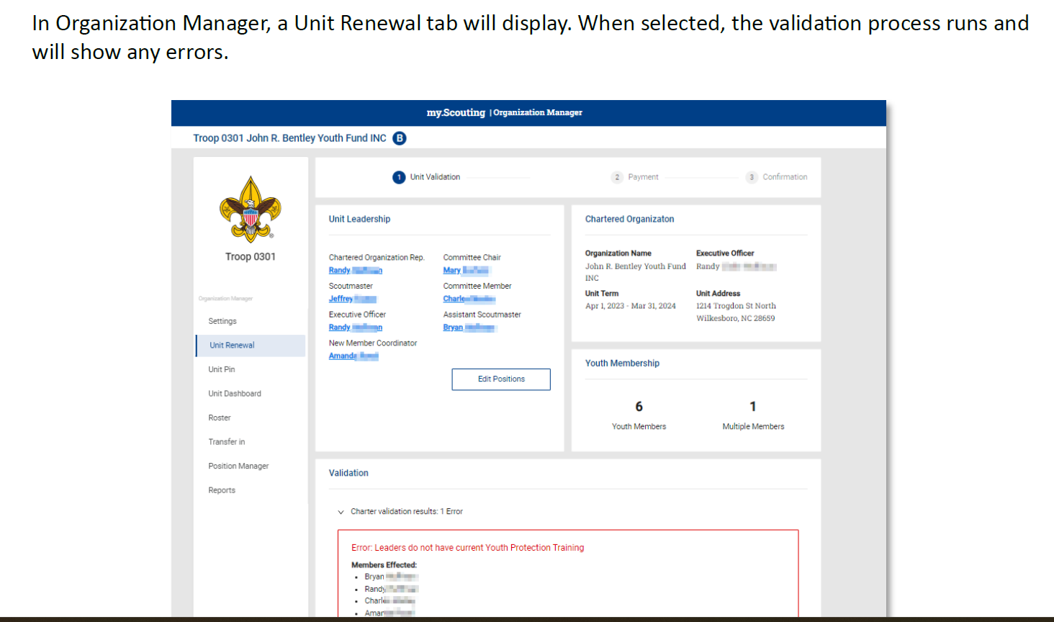

Slide 14
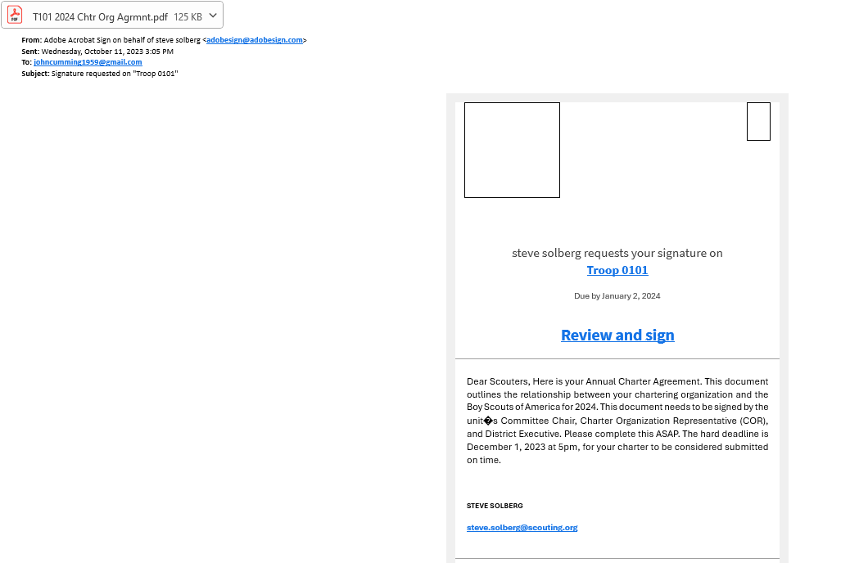

Slide 15
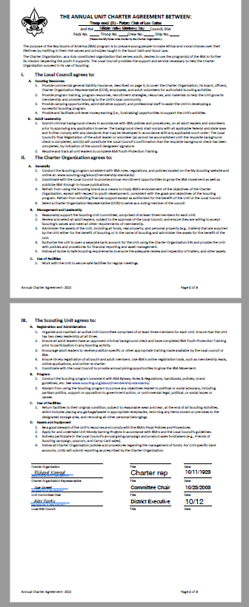

Slide 16
2. Member Renewal Process
Personal Renewal

Slide 17
This Photo by Unknown Author is licensed under CC BY

Slide 18
Individual Member Renewal
All membership terms are 12 months
Parents or Leaders can renew 2 months BEFORE membership expires
There is a 2 month “lapsed” period after the expiration date
If registered in multiple positions, select and renew the primary position.

Slide 19
Auto-Renewal Membership
For all youth and adult
members of the BSA
Note: All registrations are for 12 months. For example, if your current registration expires on 12/31/2023, your renewed membership will start on 1/1/2024 and run through the entire calendar year until 12/31/2024. Membership renewal can be completed by either the individual, the family or the unit.
Auto Renewal Membership
Family/Self Pay
Auto Renewal Membership
Unit Pay
An email notification and a renewal link will be
sent 60 days before membership expires.
The link provided in the email will direct
individuals to a renewal form on My.Scouting
If registered in multiple positions, select the primary position. Renewing the primary position will automatically renew multiple positions.
The individual pays with a credit card and submits
the renewal.
The unit will approve the membership renewal.
In Organization Manager, the unit selects the Unit Pay option.
Unit Key 3s are notified each month about which
members are due to renew that month.
Using the Roster tab, the unit selects which members they are renewing.
The unit can choose not to renew a member (opt-out). The unit can also change the Scout’s Life subscription settings for each person.
The unit pays with a credit card or establishes a securely stored electronic fund transfer payment (ACH) and submits the renewal.

Slide 20
2a. Family/Self Pay

Slide 21
Email reminder
Families will start getting emails 60 days prior to expiration reminding them to renew. Payment is made by the member (or parent) without going through the unit.

Slide 22
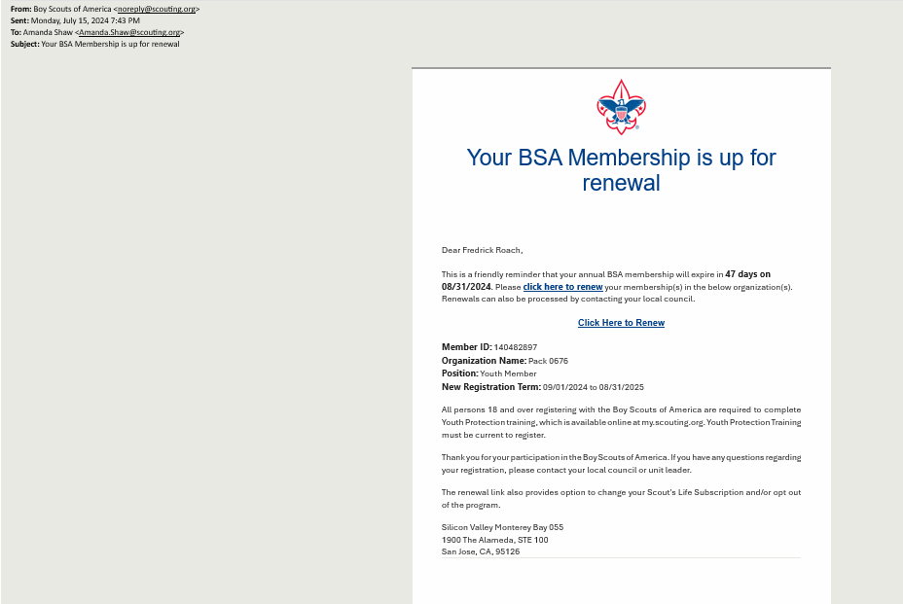

Slide 23
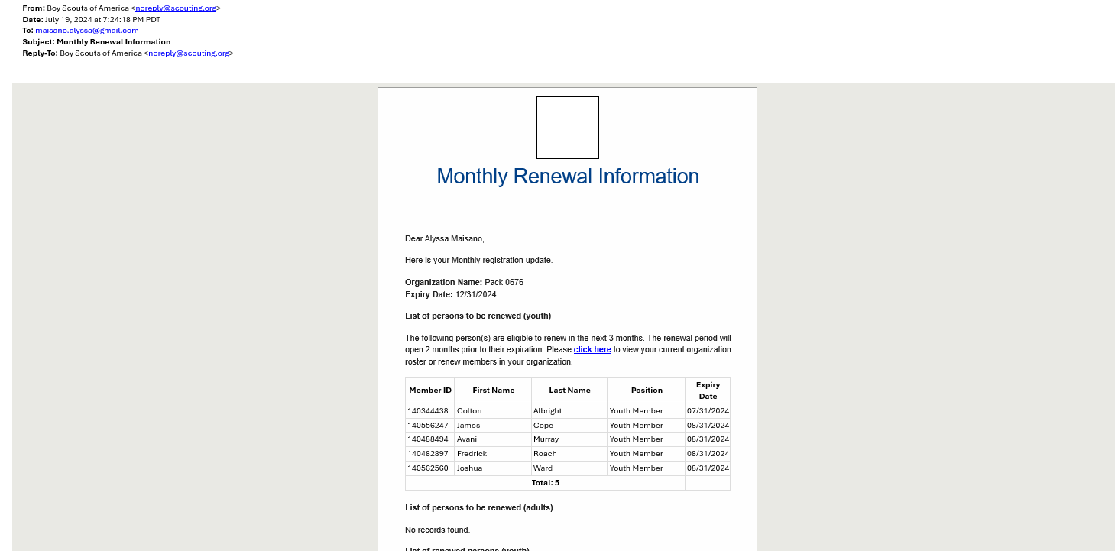
Unit also gets a list of who is coming due

Slide 24
Here is how individuals renew…

Slide 25
Individual Renewal Process
My.Scouting displays a reminder notice upon login
Click the notification icon or “My Applications” to begin
Via My.Scouting
Link from email membership renewal notice
Parents must have a My.Scouting login and be linked to their youth

Slide 26
Individual Renewal Process
Clicking the Icon will lead you to this page. Ensure information is correct and click “Go to Payment”
In “My Applications”
Go to“My Renewals”
Click “Start Renewal”

Slide 27
Adult Renewal

Slide 28
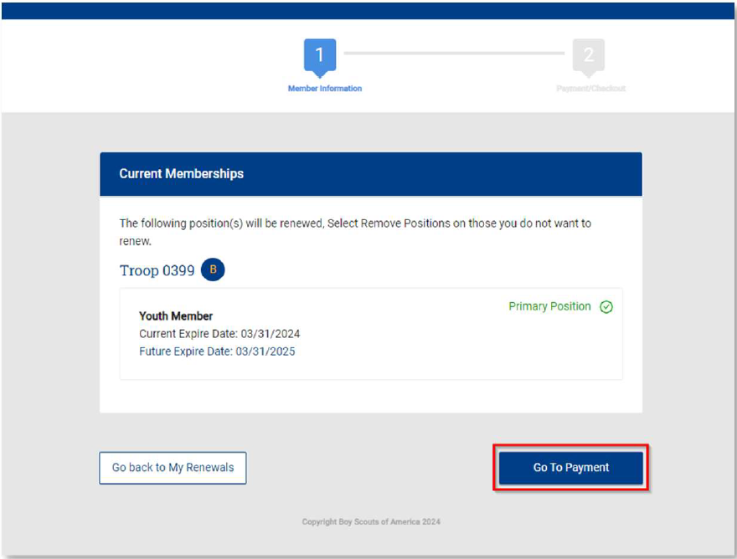
Youth Renwal
Please review and sign to agree to the BSA Terms and Conditions
Click “Go to Checkout Summary”
Ensure information is correct, then click “Go to Payment”

Slide 29
Check Out Page
Note: Scout Life Magazine subscription is opted in as a default
“Uncheck” the box to opt out
Proceed to enter payment information.
Verify billing address as process will default to record on file.
Click “Place Order” and membership is renewed.

Slide 30
Once the Credit Card process is completed, a receipt will show.
Click “Print Receipt”
or
Click on “Complete Registration” to be directed back to your applications in My.Scouting.

Slide 31
Unit Preparation and Approval for individual renewal

Slide 32
Individual Rnewal
Auto Renewal
This Photo by Unknown Author is licensed under CC BY

Slide 33
Renewal Approvals
Renewals processed at the Council or through Additional Registration does not require an approval
Units can opt-in to “Auto Approve” renewals
Scenarios where an approval is required
A Key 3 member or their delegate is approving a Unit Renewal
A Key 3 member or their delegate is approving an individual that
Renewed themselves
Were renewed by a parent/guardian
Notes:
Any Key 3 or designated delegate can only accept youth, only COR and their designated delegates can accept both youth and adults.

Slide 34
Individual Approval

Slide 35
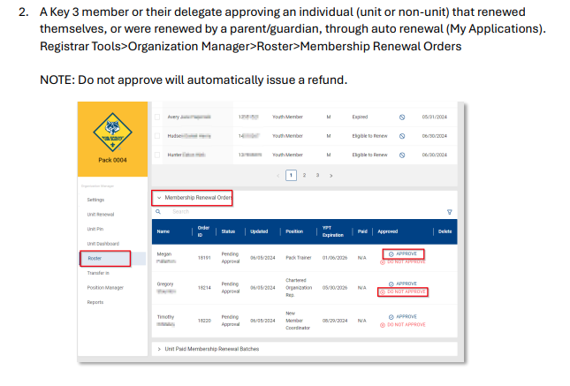

Slide 36
Auto Approval

Slide 37
26

Slide 38
2b. Unit-Paid Member Renewal
When the Unit Chooses to Renew their Members

Slide 39
2b. Unit-Paid Member Renewal
Broken- Taken Back to the Shop
When the Unit Chooses to Renew their Members

Slide 40
Unit Pay for Member Renewals
Unit Pay option for member renewal is found in the Organization Manager
Unit Key 3’s are notified each month of which members are due to renew that month
The unit selects which members are renewing
The unit pays with a credit card or establishes a securely stored electronic fund transfer payment (ACH)

Slide 41
Opt-In for Unit Pay
Found in the Settings tab of Organization Manager.
Scroll down until you see “Renewal Payment”
Check/uncheck the box “Unit will pay…”
Click “Save”

Slide 43
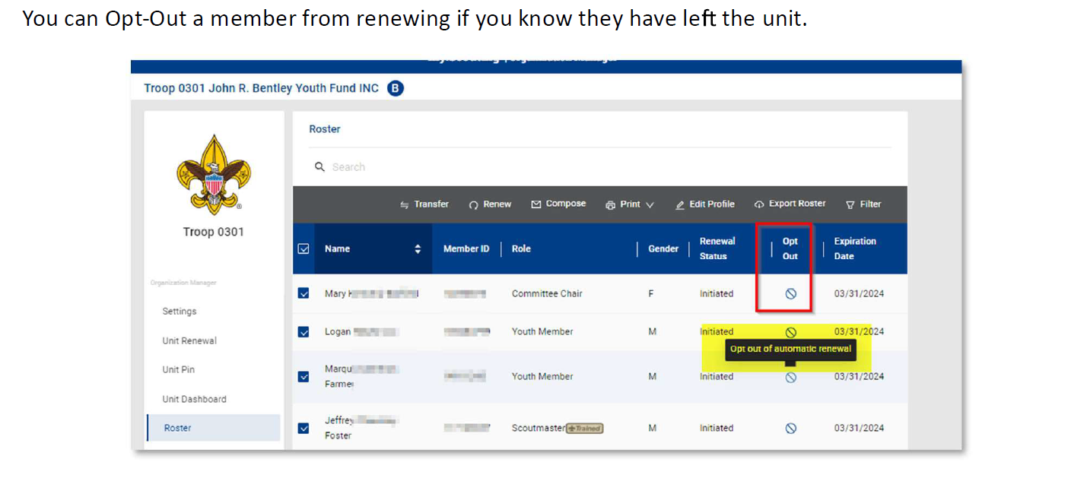

Slide 44
Units Renewing Manually
Select members to be renewed
Under the “Print” option on the roster banner select “Unit Payment of Membership Renewal”

Slide 45
A list of the members to be renewed will display
Note: Scout Life subscriptions will be selected by default. if the member does not wish to subscribe, uncheck the box.
Option to view multiple registrations
To continue with renewal, click “Create Renewal Order”

Slide 47
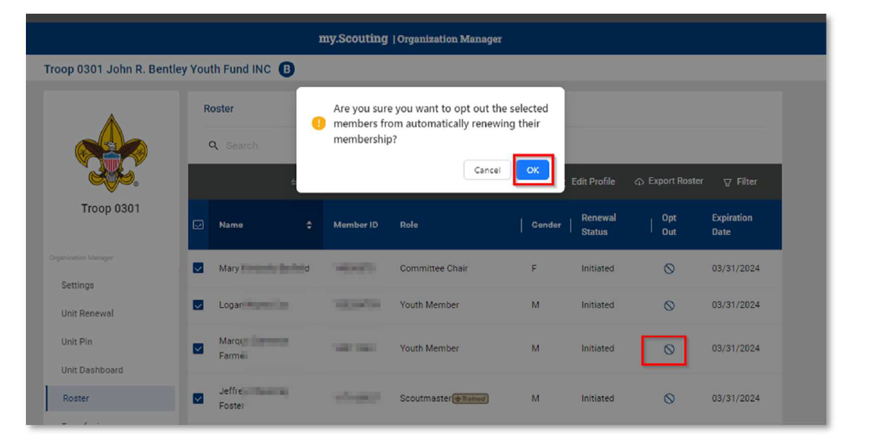

Slide 49
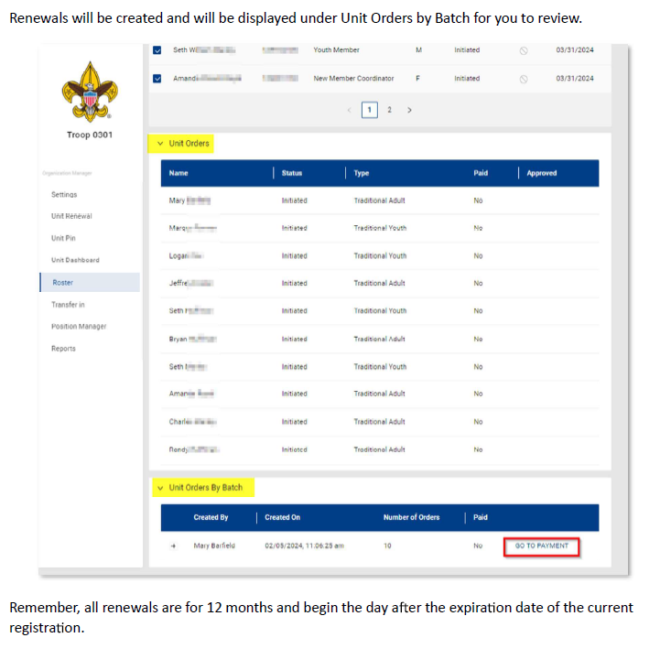

Slide 50
The Payment Summary page displays a recap and amounts due.
The option to set up credit card or ACH payment will be presented if none is on file.
Payment method can be securely saved to use for other members throughout the year.
There is a $1.00 ACH payment admin fee
There is a 3% Credit Card admin fee.

Slide 51
If unit already has a payment method saved, a recap linked to the payment method will be presented.
Click “Pay with Saved Payment Method” to complete the renewal process.
If using a different method than the one on file, select “Pay with new Method”

Slide 53
Renewal Orders initiated, but not completed, by the unit will be displayed under “Unit Paid Membership Renewal Batches” for review.

Slide 54
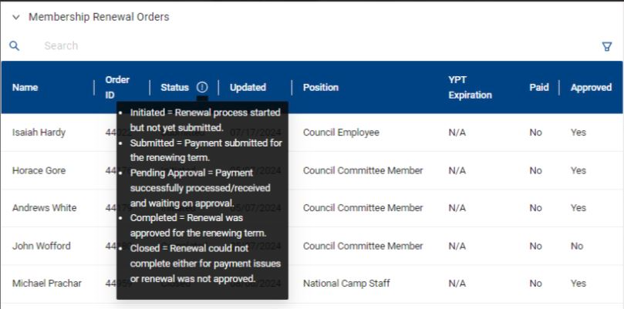

Slide 55
Monthly Unit Membership Monitoring
Found in Organization Manager

Slide 56
41

