Slide 1
Council
Popcorn Kickoff
For Kernels Silicon Valley Monterey Bay Council
July 2023
Notes:
Hi my name is Faroogh Quadri and I am the Popcorn General for the council and with me here is council popcorn staff Advisor Evgenia Mirfild. Let’s get started with our objectives for today

Slide 2
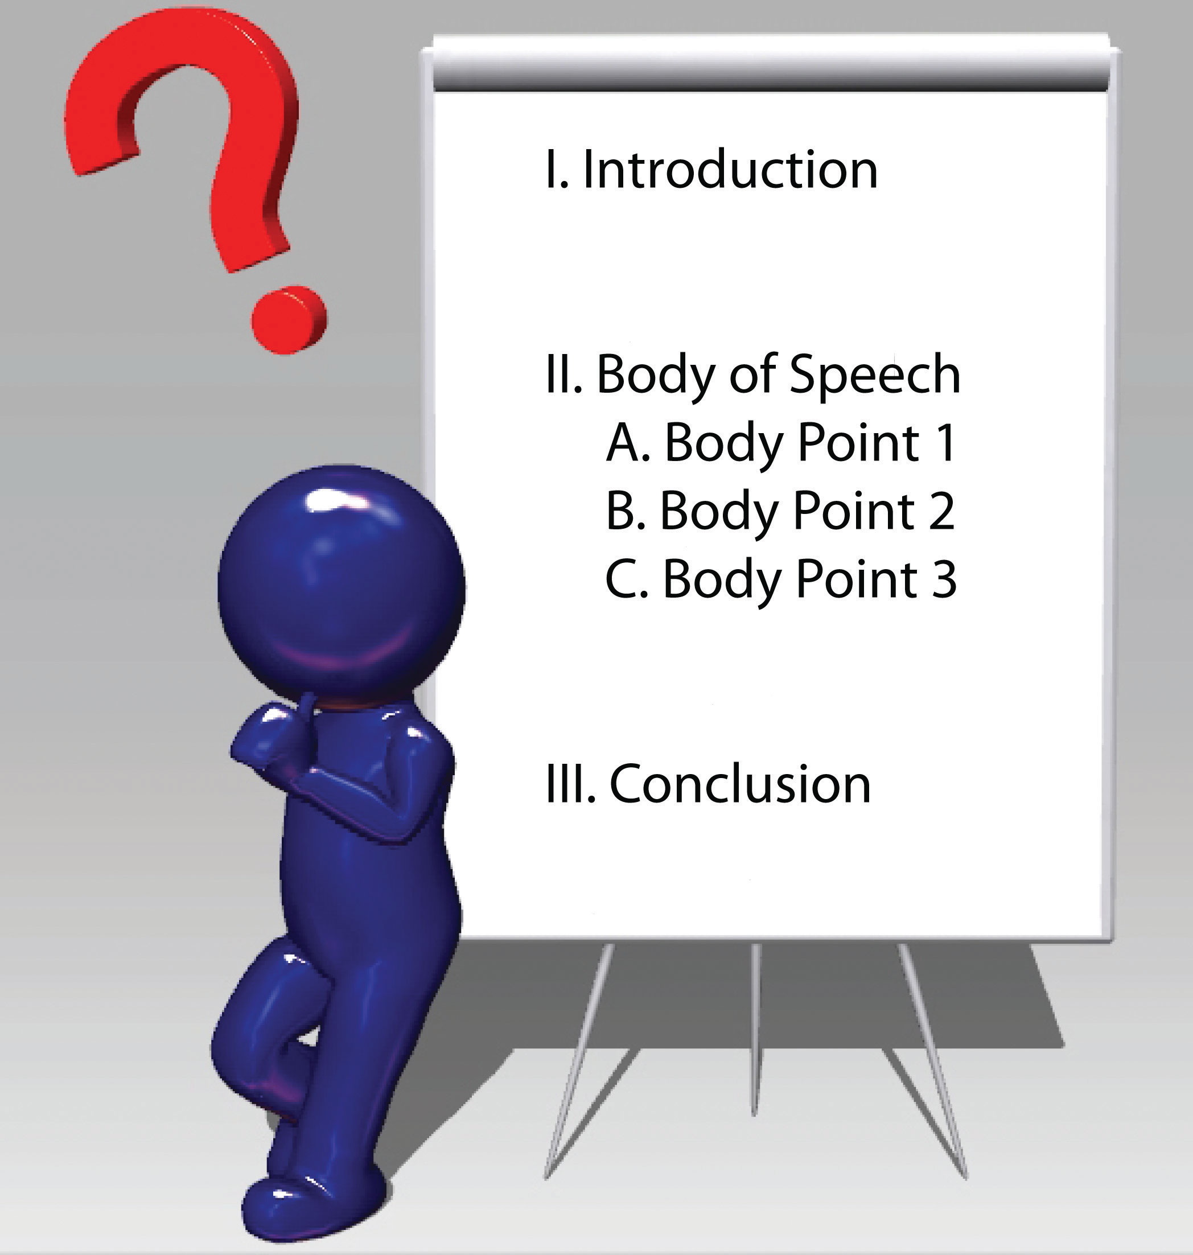
TODAY’S LEARNING OBJECTIVES?
Build your sales plan
Communicate your plan
Manage your plan
Council Sales Plan
Resources
Questions
This Photo by Unknown Author is licensed under CC BY-SA-NC
Notes:
There will be 5 key areas that I will be going over today. Let’s get started with the big question of why sell popcorn?

Slide 3
Why Popcorn?
Fund your unit’s program
Character development
Awesome Rewards
Improve our camps and council resources
More adventures, less time fundraising!
OVER $4 BILLION returned to your programs SINCE 1980
Notes:
Fundraising with popcorn help your units in funding their programs, and at the same time it helps the scout in their personal growth by learning how to manage money, public speaking, salesmanship and perseverance. Most importantly how to earn their own way, the value of hard work and on the way also earn awesome rewards. It also helps in improving our camps and council resources. Thus popcorn can fund all your program related expenses and activities that you want your Scouts to enjoy this year.

Slide 4
Popcorn = Program
Fund all your program related expenses and activities that you want your Scouts to enjoy this year, through Popcorn.
Yearly Membership Dues
Scout’s Life Magazine
Uniforms, Patches, and Awards
Camping Trips
Hikes
Christmas Party
Blue & Gold Banquet
Pinewood Derby
Meeting Supplies & Equipment
and more…
Unit Goal: $25,000 Scout Goals: $1,000 (each)
Text MYPLAN to 62771 to download: How to Sell $1,000 in under 8 hours
Notes:
And popcorn fundraising might be the only fundraiser your unit might need to fund for the whole year. These are some of the examples of the activities you might have used that popcorn money for in the past year as all of you are returning kernels. If you would like to see a plan of how to sell $1000 in under 8hrs you could text the word MYPLAN one word no spaces to 62771. you will see this image.

Slide 5
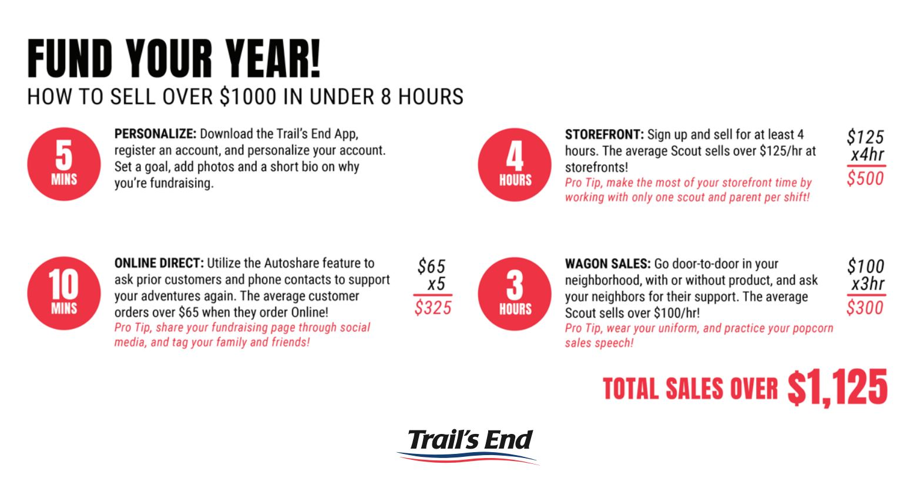
Fund Your Year
Notes:
This is one example and we will go more in detail in the next few slides. Let’s start with the first objective

Slide 6
STEP ONE- BUILD YOUR PLAN
This Photo by Unknown Author is licensed under CC BY-SA-NC

Slide 7
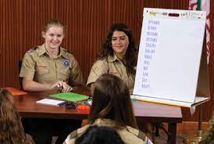
STEP ONE- BUILD YOUR PLAN
Why is your unit selling popcorn?
Is it part of the unit program plan?
Start with a Program Planning Meeting
What is the calendar of activities
What is the budget
How much do we NEED to raise from Popcorn?
Notes:
What is the target that you have chosen for your unit. How many people do you need for example if you are picking up inventory for 50 scouts you will need at least 3-4 drivers to pick up all your boxes

Slide 8
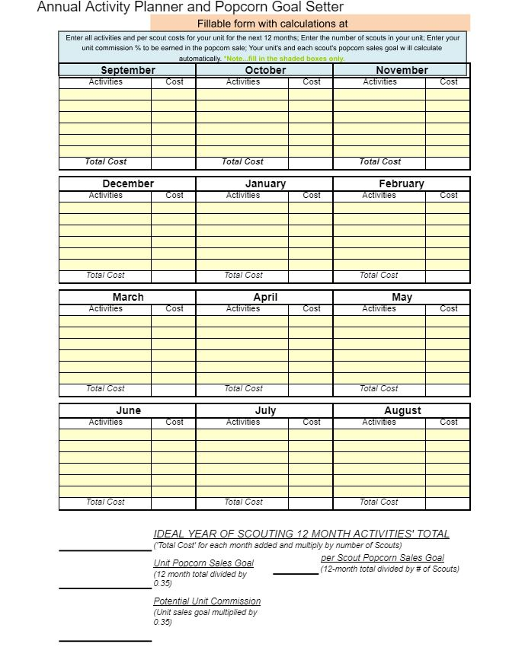
STEP ONE- BUILD YOUR PLAN
Sample Budget Sheet
Notes:
Sample Budget sheet is in your leader’s Guide as well that is available on svmbc.org/popcorn

Slide 9
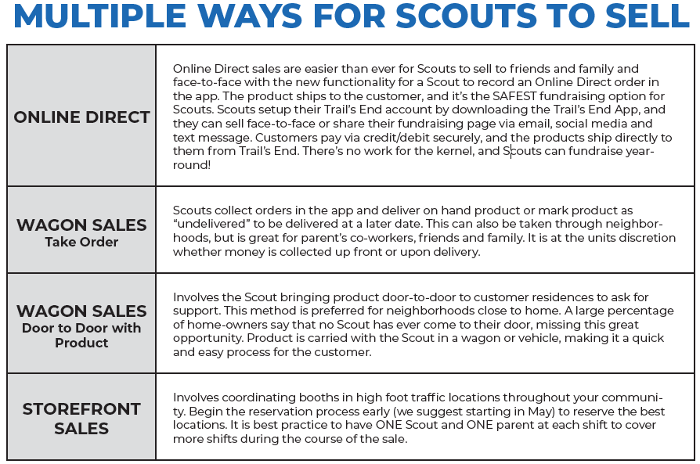
STEP ONE- BUILD YOUR PLAN
Notes:
As all of you are aware of these 4 methods that we have used before which can be categorized into 3 main groups online, wagon sales and storefront

Slide 10
THIS YEAR’S PLAN: Methods
Notes:
Mention Presales. Online sales are easier than ever for scouts to sell to friends and family. The trail’s end app also allows you to take a face to face online direct order and then it gets ship to the customer so no work for the kernel and the scouts can fundraise year round. Even though you will get he first product in August you can do the presale on the app right now and I have seen some units have started online already.

Slide 11
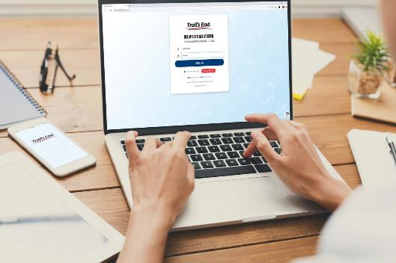
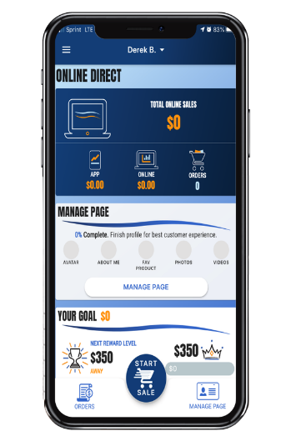
THIS YEAR’S PLAN:
Get Connected and Log In
Download App if you haven’t already
An account from last year will work again
Log In works on App and Desktop
The Unit Leader Portal is now mobile friendly where Units can access the portal while at a storefront or on the go.
Units can manage their entire sale from their phone.
Login at:
www.Trails-End.com with your Trail’s End Leader account.
Notes:
This year trail’s end has made it easier for unit leaders by making the app mobile friendly where leaders can access the portal while on a storefront or on the go.

Slide 12
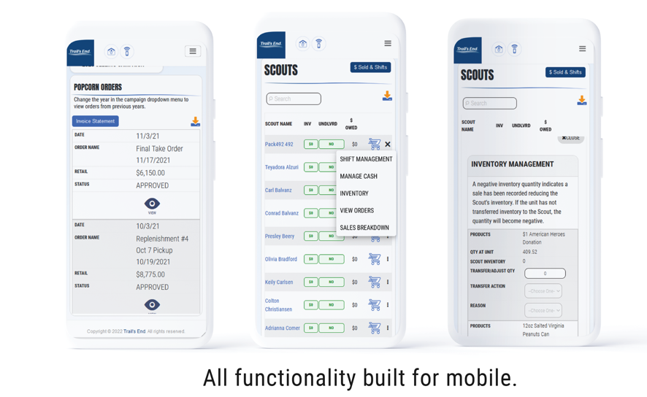
THIS YEAR’S PLAN:
Notes:
This year trail’s end has made it easier for unit leaders by making the app mobile friendly where leaders can access the portal while on a storefront or on the go.

Slide 13
THIS YEAR’S PLAN:
Notes:
The app is available in the apple or google play store. You will need the council, district and unit number to register. For scouts they will have to sign into their own account as you may be aware of that. Once they log in we recommend that

Slide 14
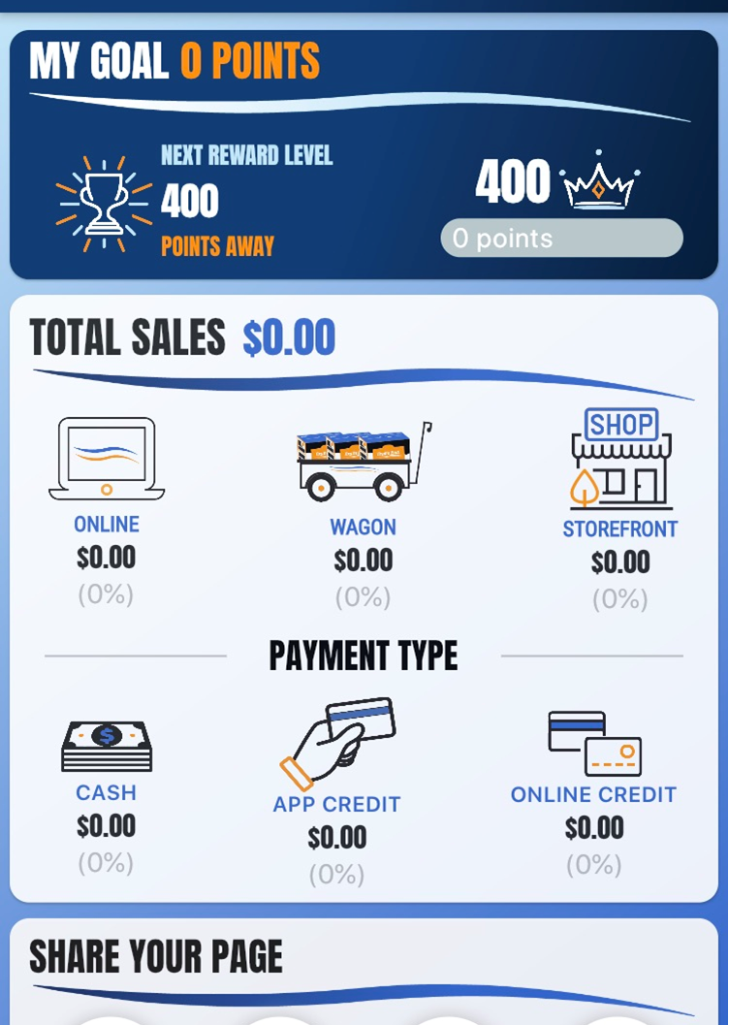
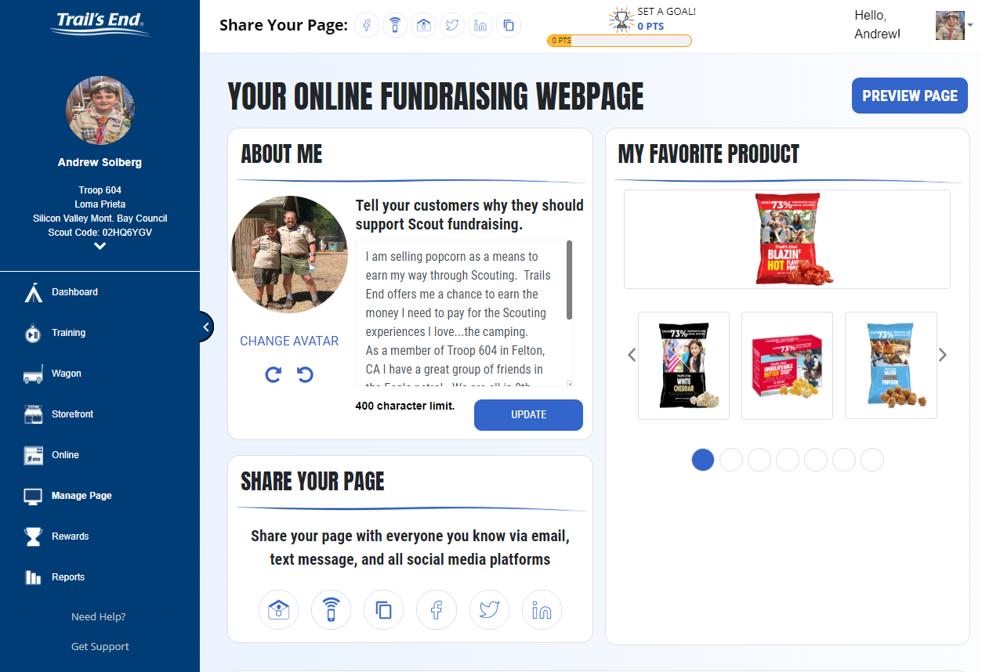
THIS YEAR’S PLAN: Online Sales
Change your avatar- use a picture of you in uniform
Fill in “Why people should support you”
Pick your favorite product
Upload pictures of yourself doing things
Notes:
These items. Once completed they share with family and friends.

Slide 15
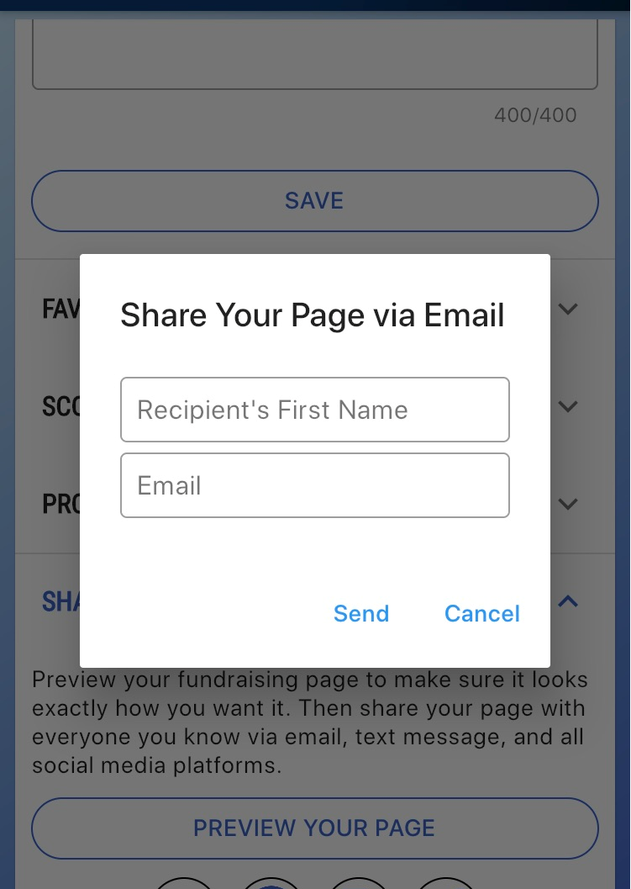
THIS YEAR’S PLAN: Online Sales
Share from within platforms
Send direct emails
Send direct texts
Post on Social Media
Facebook
Twitter
Discord etc
Notes:
The second method is by wagon sales

Slide 16
THIS YEAR’S PLAN: Methods
Notes:
I am not going to spent much time on this as you all have done this before. Where a scout goes door to door to sell the product or take orders and brings the product to the customer. Here is the picture of one such sale

Slide 17
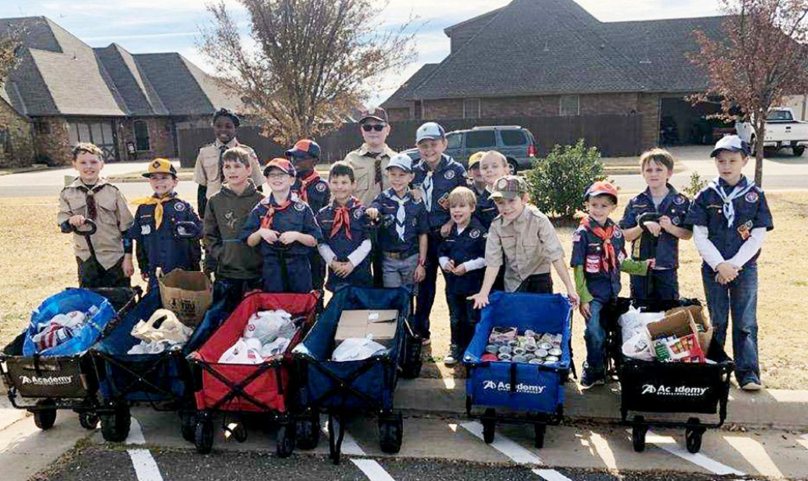
THIS YEAR’S PLAN: Wagon Sales

Slide 18
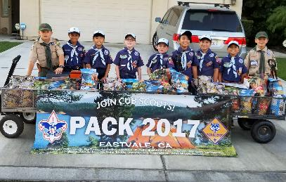
THIS YEAR’S PLAN: Wagon Sales
DOOR TO DOOR
Neighbors
$28 Avg. Transaction, $200/hr
FRIENDS,FAMILY, WORKPLACE
Door to Door
Friends & Family, Workplace
Notes:
Wagon sales are great way to sell to friends, family and workplace.

Slide 19
THIS YEAR’S PLAN: Wagon Sales
SAVE TIME MANAGING YOUR SALE!
The app for Scouts to track and report real-time storefront, wagon and online sales, accept cash and credit cards, track inventory by Scout and storefront, and schedule Scouts for storefronts.
FREE CREDIT CARD PROCESSING
Powered by Square | Paid by Trail’s End
Every Scout, every sale will receive free payment processing.
Square is the leading credit card solution for units.
Compatible with all Square Readers (not required to take credit cards).
SIMPLER AND SMOOTHER INTERFACE
NEW and IMPROVED in 2022!
Storefront and shift management.
NEW ‘text order/cart’ feature for socially distant payments.
Scout families can turn in cash payments via credit card.
Notes:
Most important for wagon sales is to be able to take the payment by credit card and square makes it easy to do. You do not even have to have the device to take credit card you can even key in the numbers. It also allows scout families to turn cash payment via credit card.

Slide 20
THIS YEAR’S PLAN: Methods
Notes:
The 3rd category is the storefront.

Slide 21
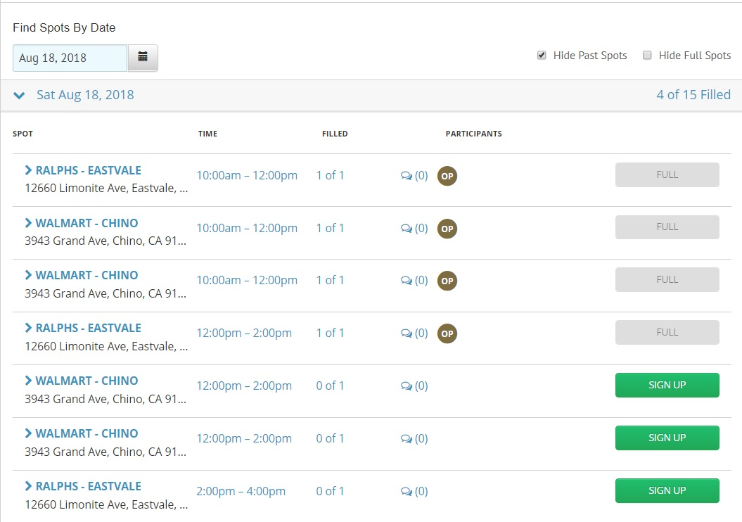
THIS YEAR’S PLAN: Store Front
Store Front
All Store Scheduling done
by Trails End
Pick your stores from
Leader Portal
Notes:
Next slide I will show you the image of where it is located on the dashboard

Slide 22
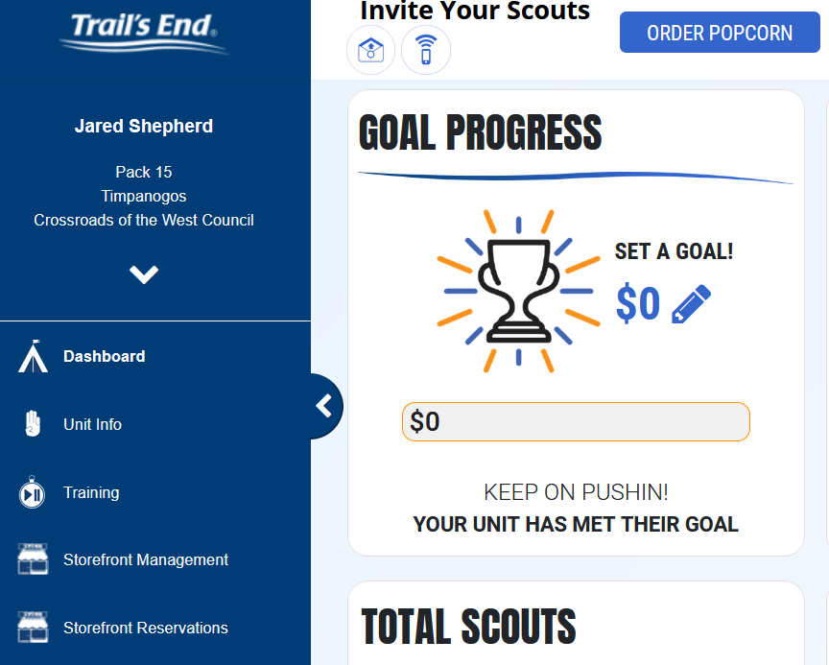
THIS YEAR’S PLAN: Store Front
Notes:
Next slide I will show you the image of where it is located on the dashboard

Slide 23
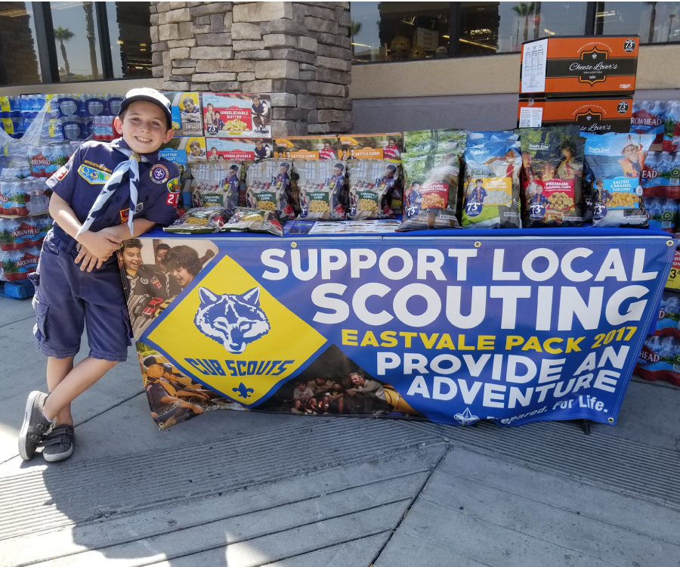
THIS YEAR’S PLAN: Store Front
Store Front
Scalable – More Scouts, More Shifts
One Scout per Shift (2 Hours)
$250 per Shift Average
Maximize Sales Per Scout Hour
Train Scouts & Parents
Presentation Matters

Slide 24
THIS YEAR’S PLAN: Store Front
Storefront process available Saturday, July 15th. Schedule below.
Saturday, July 15th - $20K & above Units, 3 Reservations within District
Sunday, July 16th - $20K & above Units, 3 Reservations within District
Monday, July 17th – $10K & above Units, 2 Reservations within District
Tuesday, July 18th – $10K & above Units, 2 Reservations within District
Wednesday, July 19th – All Units, 2 Reservations within District
Thursday, July 20th – All Units, 2 Reservations within Council
Friday, July 21st – All Units, Unlimited Reservations within Council

Slide 25
STEP TWO- COMMUNICATE THE PLAN
This Photo by Unknown Author is licensed under CC BY-SA-NC
Notes:
Now that you have all the storefronts booked you get to the step 2 which is to communicate the plan

Slide 26
STEP TWO- COMMUNICATE THE PLAN
KICKOFF
SCOUT MOTIVATION
PARENT BUY-IN
REGULAR COMMUNICATION

Slide 27
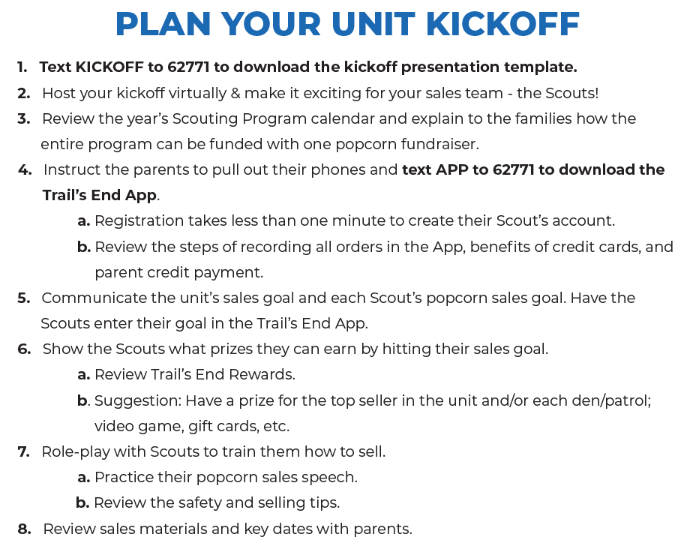
STEP TWO- COMMUNICATE THE PLAN
Notes:
You can download the kickoff presentation by texting the work kickoff to the same number 62771. It is a great resource for kick off. There are 5 key items in planning the kick off which are making sure all parents have downloaded the trail’s app by texting the word app to 62771. They understand the units goals and all the programs this fundraiser will assist in. Have the scout’s set a goal for themselves and the goal for the unit.

Slide 28
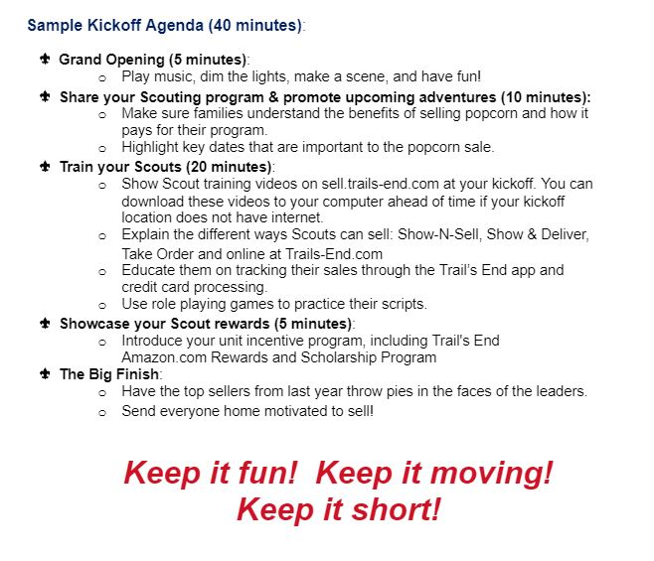
STEP TWO- COMMUNICATE THE PLAN
Sample Kickoff Agenda
Notes:
You can download the kickoff presentation by texting the work kickoff to the same number 62771. It is a great resource for kick off. There are 5 key items in planning the kick off which are making sure all parents have downloaded the trail’s app by texting the word app to 62771. They understand the units goals and all the programs this fundraiser will assist in. Have the scout’s set a goal for themselves and the goal for the unit.

Slide 29
STEP TWO- COMMUNICATE THE PLAN

Slide 30
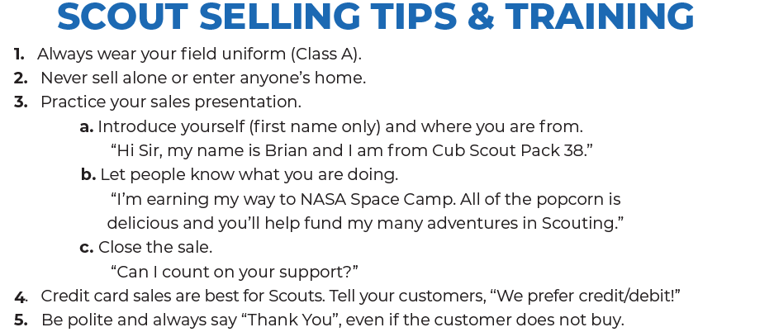
KICKOFF

Slide 31
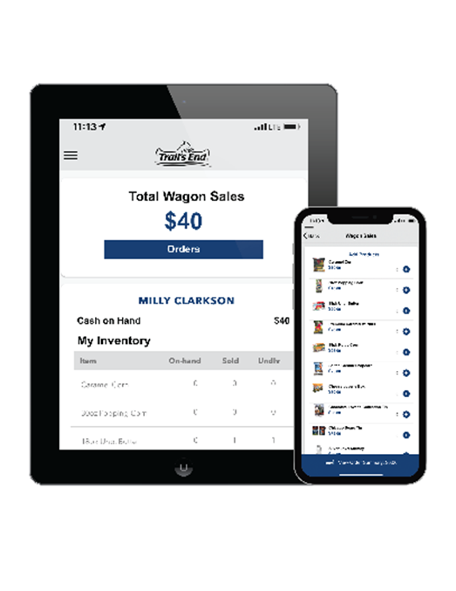
KICKOFF
ALL FAMILIES USE THE APP
Record all Sales
Manage your inventory
Schedule your workforce
Take Credit Cards
TAKE CREDIT CARDS !

Slide 32
STEP TWO- COMMUNICATE THE PLAN
SCOUT MOTIVATION
Every Scout Sells
Set a Goal For Each Scout
Prizes

Slide 33
STEP TWO- COMMUNICATE THE PLAN
SCOUT MOTIVATION
SCOUTS BUY THE PRIZES THEY WANT WITH AN AMAZON.COM GIFT CARD
Amazon.com Gift Cards are claimed on the Rewards page within the Scout’s account in the app and Trails-End.com when certain sales levels are reached and approved by a unit leader.
BENEFITS FOR SCOUTS
Higher prize value than other fundraisers
Millions of prizes to choose on Amazon.com
Prizes delivered directly to your door faster than ever before

Slide 34
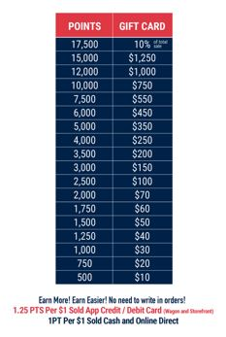
TRAIL’S END REWARDS
BUY THE PRIZES YOU WANT WHEN YOU EARN AMAZON.COM GIFT CARDS
WHY DO KIDS LOVE TRAIL’S END REWARDS
You get to buy the prizes you want!
The more you sell, the more you earn.
Millions of prize choices on Amazon.com.
Get your prizes faster and delivered directly to you.
Bigger and better prizes than ever before!
WHY DO LEADERS LOVE TRAIL’S END REWARDS?
Less work!
No collecting orders from families or distributing prizes.
Simplified sale management.
The Trail’s End Leader Portal is a one-stop shop for everything, including prize ordering.
Orders are tracked automatically for leaders when kids sell with the App and Online.
It’s easy to communicate and manage because face-to-face and online sales count towards Rewards.
Trail’s End helps train and motivated kids through the app.
Leaders can wrap up the fundraiser and get back to unit adventures faster!

Slide 35
STEP TWO- COMMUNICATE THE PLAN
SCOUT MOTIVATION
In addition to the Trail’s End Rewards program, your scouts can earn the following:
Top 100 sellers will be invited to Big Spin party
Every Scout that sells $683 of popcorn will receive a special patch

Slide 36
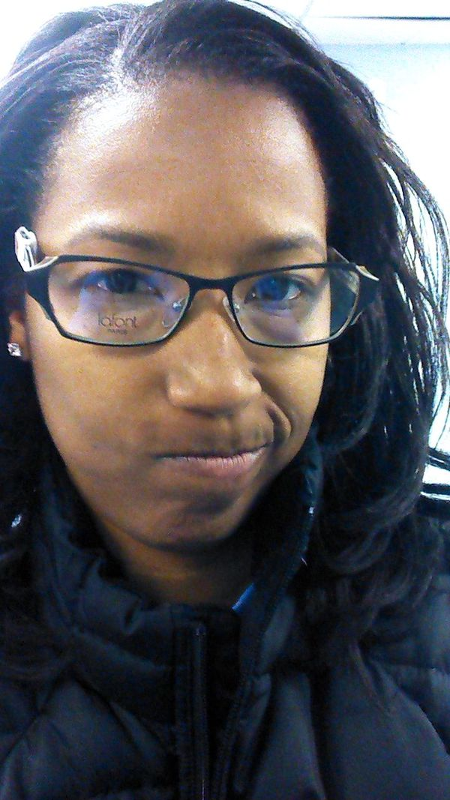
STEP TWO- COMMUNICATE THE PLAN
Earn Parent Buy-In
WIIFM
What’s
In
It
For
Me
This Photo by Unknown Author is licensed under CC BY-NC-ND

Slide 37
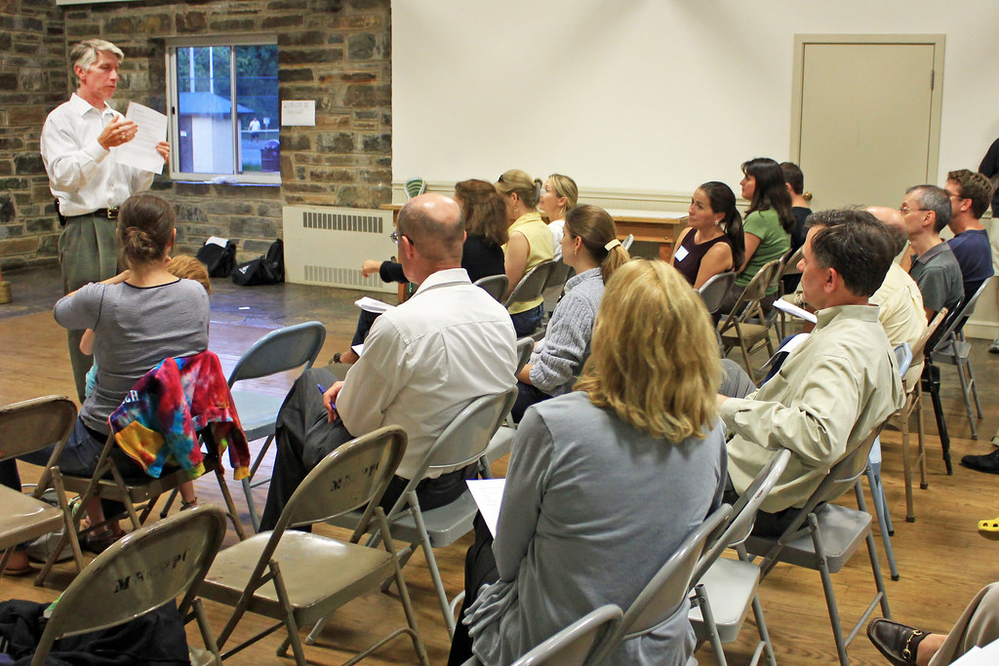
STEP TWO- COMMUNICATE THE PLAN
Earn Parent Buy-In
Scout’s Personal Growth
One Fundraiser, No Dues
8 Hours Per Year
It’s what we do
Make It Easy
This Photo by Unknown Author is licensed under CC BY

Slide 38
STEP TWO- COMMUNICATE THE PLAN
REGULAR COMMUNCATION
vFrom: main@Troop286.groups.io <main@Troop286.groups.io> On Behalf Of Brian Kraje Sent: Wednesday, May 5, 2021 12:12 PM To: troop286@groups.i#o Subject: [Troop286] Are you kidding me? It's only May and Mr. Kraje is chirping about popcorn?!
Yah that’s right 286! This is the time of the year when the early bird gets the whole enchilada. Wait, what? 😉
No pressure to sell, but if you feel like making some bank, we got probably the best promos we’ll see all 2021, going on right now.
Trails End is giving you 3X points for any Online Direct sale through 5 PM May 16. And if any single order comes in at $100 or more, you get 100 more points added in, every time, through 5 PM May 31. So? Well, if you make it to the highest-selling Trail’s End Rewards tier this year, that’s up to 40 cents right back to you in Amazon cards for every dollar you move, right now. I can’t say for sure, but my gut is we won’t see this level of points flying out the door for the rest of the year.
Notes:
Sometimes trail’s end might have a promotion for online sales or free shipping. You as popcorn kernel are required to communicate that info to your unit. In short regular communication with the parents and making them aware of incentives given by trail’s end is the job of the popcorn kernel.

Slide 39
STEP TWO- COMMUNICATE THE PLAN
REGULAR COMMUNCATION
Reference Document for Sale Details
Each Scout’s Goal and Family Commitment
Confirm Store Shifts
Update/Remind of Schedule Dates
Update on progress in sale

Slide 40
STEP THREE- MANAGE YOUR SALE
This Photo by Unknown Author is licensed under CC BY-SA-NC

Slide 41
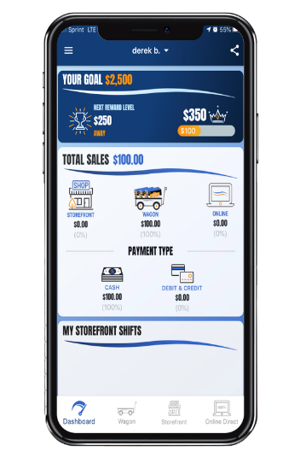
STEP THREE- MANAGE YOUR SALE
Notes:
As I have mentioned before you can manage the sale by your mobile device and desktop/laptop

Slide 42
STEP THREE- MANAGE YOUR SALE
SAVE TIME MANAGING YOUR SALE!
www.trails-end.com
Manage your unit’s sale ALL in one place!
Order Popcorn; easy prize submission; set your
unit/Scout goal
Invite your Scouts to register; manage Scout roster
View real-time sales, inventory, and cash management
UNIT to UNIT product transfers
Create, schedule, and manage storefront sites and shifts

Slide 43
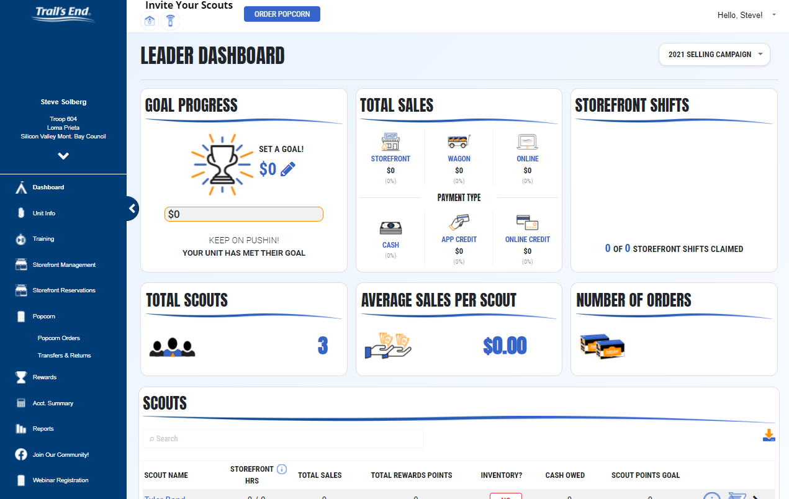
STEP THREE- MANAGE YOUR SALE
LEADER PORTAL
Order popcorn

Slide 44
STEP THREE- MANAGE YOUR SALE
LEADER PORTAL
Set Goal

Slide 45
STEP THREE- MANAGE YOUR SALE
LEADER PORTAL
Claim Shifts

Slide 46
STEP THREE- MANAGE YOUR SALE
LEADER PORTAL
Add Scouts
Invite Scouts to Sell referring to Icon Unit Info

Slide 47
STEP THREE- MANAGE YOUR SALE
LEADER PORTAL
Order Prizes referring to icon Rewards

Slide 48
STEP THREE- MANAGE YOUR SALE
LEADER PORTAL
Get Your Invoice
Get Your Money

Slide 49
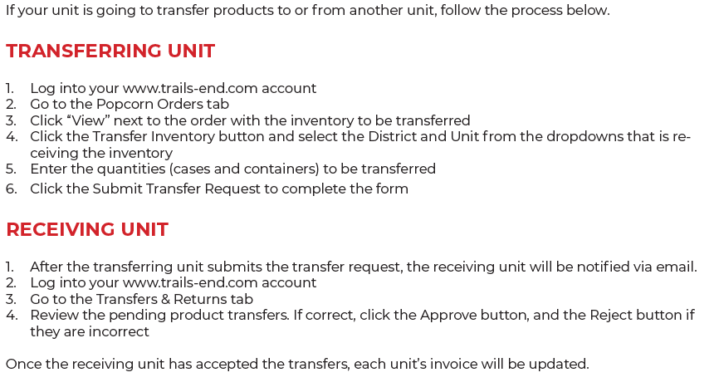
STEP THREE- MANAGE YOUR SALE

Slide 50
FOUR- COUNCIL SALES PLAN
This Photo by Unknown Author is licensed under CC BY-SA

Slide 51
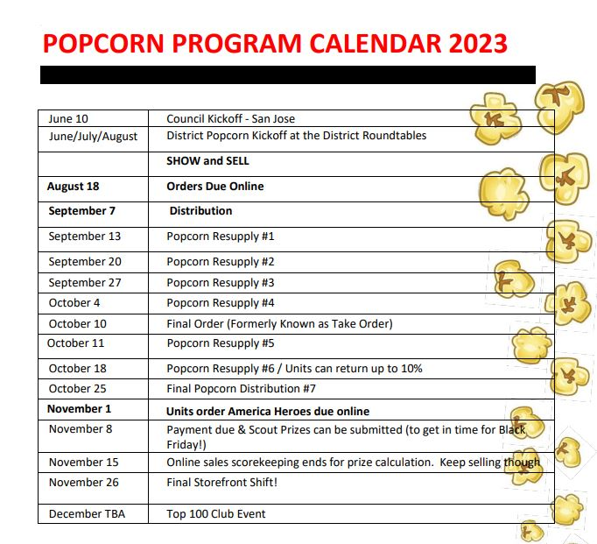
FOUR- COUNCIL SALES PLAN
CALENDAR

Slide 52
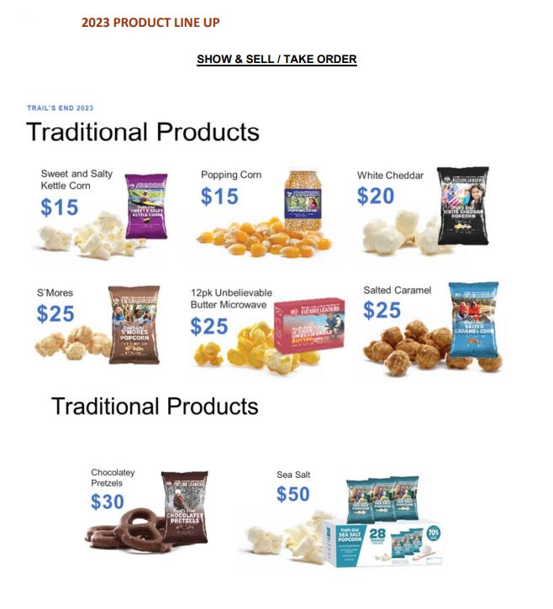
FOUR- COUNCIL SALES PLAN
PRODUCT LINE

Slide 53
FOUR- COUNCIL SALES PLAN
2023 COMMISSION STRUCTURE
Traditional (Wagon/Storefront) Base Sales Commission = 23%
Attend Council or District Kickoff +1%
Host Unit Kickoff +1%
Submit your program/budget +1%
75% of unit’s scouts participate +4%
$683 Average sales per scout
or $20K/unit + 3%
$1,750 sales per scout or $40K/unit + 3%
Total available Commission = 36%
Online Sales Commission = 30%
Late payment penalty -3%
This Photo by Unknown Author is licensed under CC BY-SA-NC

Slide 54
PICKING UP MORE
Every Wednesday (Sept 13- Oct 25)
Customer Service
Stay in your car- Fill out form
We load it
You drive off and sell it
Notes:
First distribution is on Thursday September 7th for orders that were placed on August 18. After that you can pick up every Wednesday starting Sept 13 till Oct 25

Slide 55
FOUR- COUNCIL SALES PLAN
RETURNS
Notes:
As returning Kernels you might be aware that this year there is no Amnesty Day and units can only return 10% of the original order.

Slide 56
FIVE- RESOURCES
This Photo by Unknown Author is licensed under CC BY-SA

Slide 57
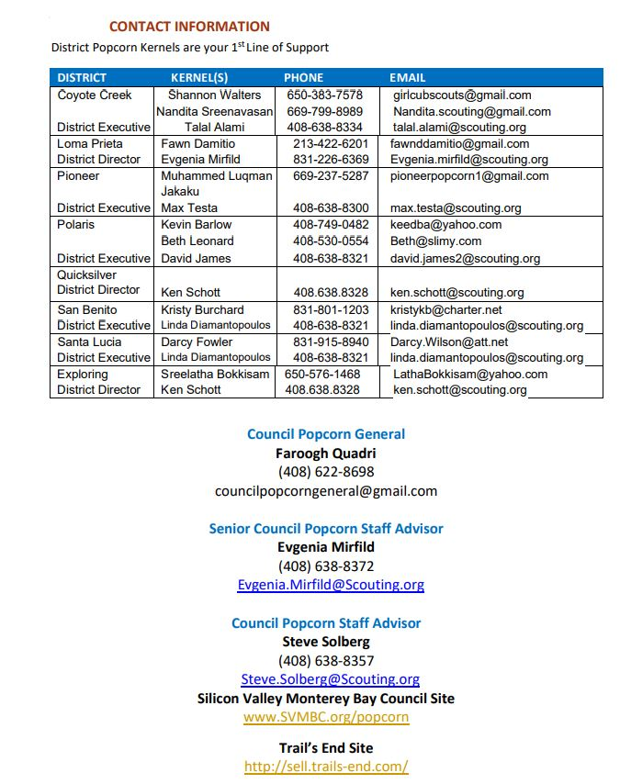
Support
2023 LEADERS GUIDE
COUNCIL CONTACT INFO
Notes:
Presenter: Candice

Slide 58
Appendix: Resources
Text the keywords below to 62771 to Download.
Leaders | Keyword | Description
 | KERNELGUIDE | Popcorn Kernel Guide (PDF)
 | KICKOFF | Unit Kickoff Presentation (PPT)
 | WEBINAR | Link to Webinar Registration Portal
 | FACEBOOK | Link to join the Trail's End Facebook Group
Scouts | APP | Link to download the Trail's End App
 | APPGUIDE | App Quick Start Guide for Scouts (PDF)
 | MYPLAN | How to Sell $1,000 Social Distancing (PDF)
 | SCOUTFB | Link to join the Trail's End Scout Parents Facebook Group
 | REWARDS | Trail's End Rewards Flyer (PDF)
 | ORDERFORM | Take Order Form (PDF)

Slide 59
Facebook Groups
CREATED & MANAGED BY POPCORN KERNELS
Get your questions answered and share ideas between unit leaders
across the country about the Trail’s End popcorn fundraiser.
Discover best practices with other unit leaders and learn new popcorn sale ideas.
Have direct access to Trail’s End when your unit needs support and share ways Trail’s End can serve your fundraising needs better.
Text FACEBOOK to 62771 to join today!

Slide 60
Support
CONTACT TRAIL’S END SUPPORT
JOIN OUR FACEBOOK GROUP
Text FACEBOOK to 62771 to join
JOIN OUR WEBINARS
Text WEBINAR to 62771 to register
VISIT OUR WEBSITE
www.trails-end.com
EMAIL US:
support@trails-end.com
NEED HELP? VISIT OUR FAQs:
support.trails-end.com
COUNCIL CONTACT INFO
Evgenia Mirfild: Council Popcorn Staff Advisor
Evgenia.Mirfild@scouting.org
(831) 226-6369
Faroogh Quadri: Council General
councilpopcorngeneral@gmail.com
(508) 498-1245

Slide 61
NEXT STEPS
Notes:
End Slide Option 2

Slide 62
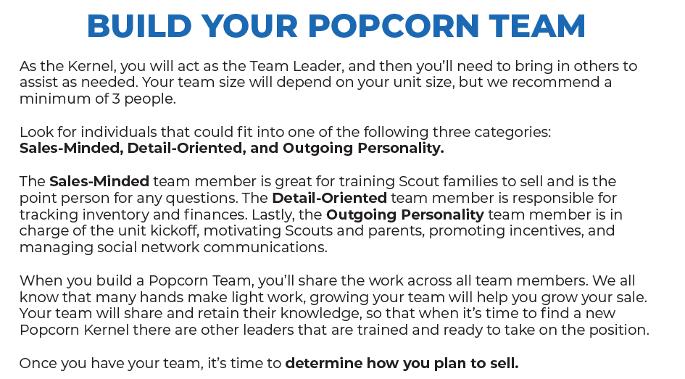
NEXT STEPS

Slide 63
KEY DATES
Event | Dates
Orders Due | 8/18/2023
First Distribution | 9/07/2023
Warehouse open for more | Every Wednesday
Final Order (formerly known as Take Order) | 10/10/23
Product return (up to 10%) | 10/18/23
Payment Due to council & scout prizes can be submitted | 11/15/23
Notes:
These are some of the key dates to remember and are posted on the svmbc.org/popcorn website as well.

Slide 64
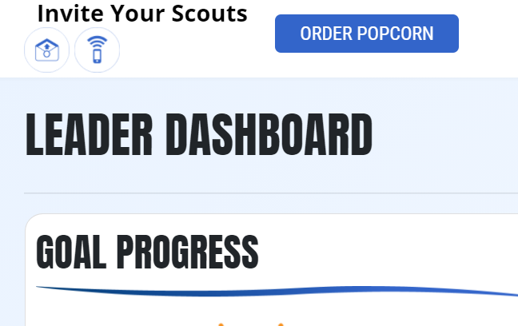
Steps to Success
Attend a Trail’s End Webinar
Register at www.trails-end.com/webinars
Build Your Plan
Selling Methods
Unit Incentives (Small trophies or medals)
Communication
Unit Kickoff
Invite Scouts to Register
Hold ‘High Energy’ Unit Kickoff
Present 2023 Program Plan and Budget
Parent Buy-In
Scout Training
All Scouts Registered on Trail’s End App.
LEADER PORTAL
Notes:
In summary, I would re-it-er-ate that to have a successful popcorn fundraiser get comfortable with the leader portal of Trail’s end and hold a high energy kickoff and get all your parents to sign up on the trail’s end app.

Slide 65
Register Now
Visit the link below to get your Unit signed up today to learn more about the 2022 Popcorn Sale!
www.trails-end.com/unit-registration
www.trails-end.com/webinar
Agenda
Products

Slide 66
Register for a Webinar
Agenda
Products
Notes:
Register for a webinar as well there is one coming up for returning kernels on July 23, 2022. That is all from me today do you have any questions for me.

Slide 67
Questions?
Comments?
This Photo by Unknown Author is licensed under CC BY-NC-ND
Notes:
End Slide Option 2

Slide 68
THANK YOU!
Notes:
End Slide Option 2

