Slide 1
Setting up your Team (Table Host) page on OneCause

Slide 2
But First.. What is the role of Table Host?
Host a table at the Community Breakfast for Scouting and provide leadership to raise a minimum of $3500 through your invited guests.
Action Items:
Help identify and recruit 9 community leaders and peers to attend the Community Breakfast for Scouting as guests at your table. You are the 10th guest.
Review the table host packet and support materials. Work with campaign leadership to select historic donors, suggest new guests for your table, and coordinate with other table hosts to prevent duplicate invitations to guests.
Reach out to your guests personally and ask for them to join you at your table. Hosts are provided with electronic and printed materials, speaker bios and sample communications including social media posts and local Scouting impact.
The council will mail Save the Date postcards to past participants as an additional way to get the word out.
Provide a personal or corporate gift to the Friends of Scouting Campaign.
Strive to reach your goal of a minimum of $3,500 per table.

Slide 3
Visit our page: https://p2p.onecause.com/bsabreakfast2023

Slide 4
Type in a name to find an existing team or…

Slide 5
Click on existing team and Join by clicking the blue Join the Team button

Slide 6
Fill in your Team Information including a Team Name and you’ll have your customized URL for sharing. Don’t forget to set a fundraising goal!

Slide 7
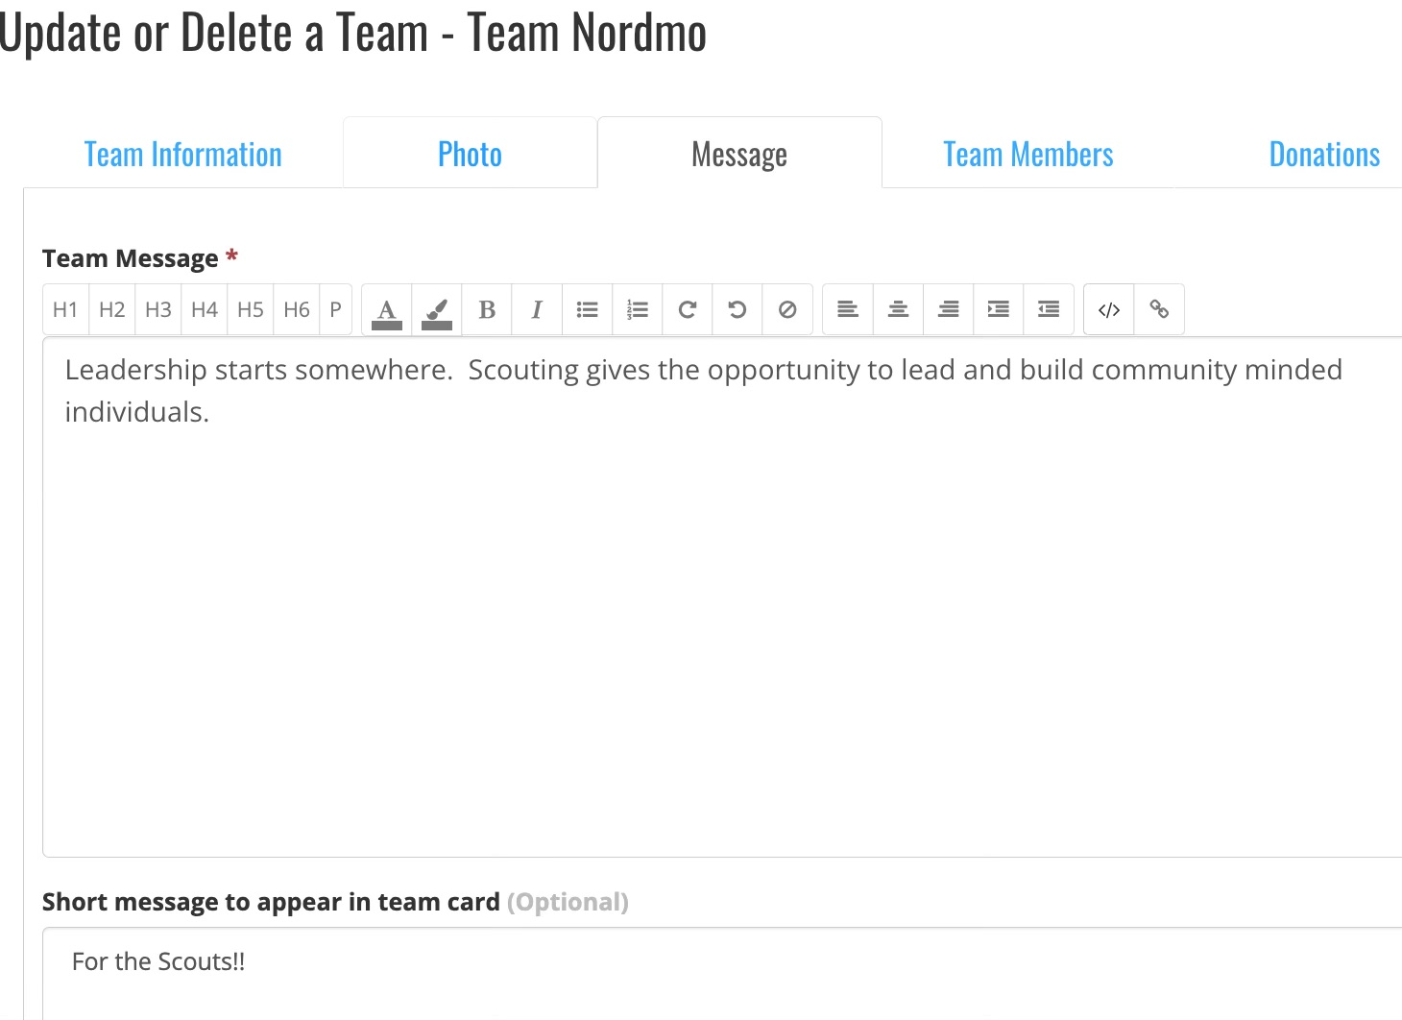
Put a personal touch on your page by adding a photo and/or video to demonstrate Scouting in Action for your donors to see and to help tell the Scouting story! At a minimum, share your Scouting “why” message

Slide 8
Go to the ‘What’s happening’ dropdown and select Leader Boards link to see how your team compares to other teams and fundraisers!

